Slide 1

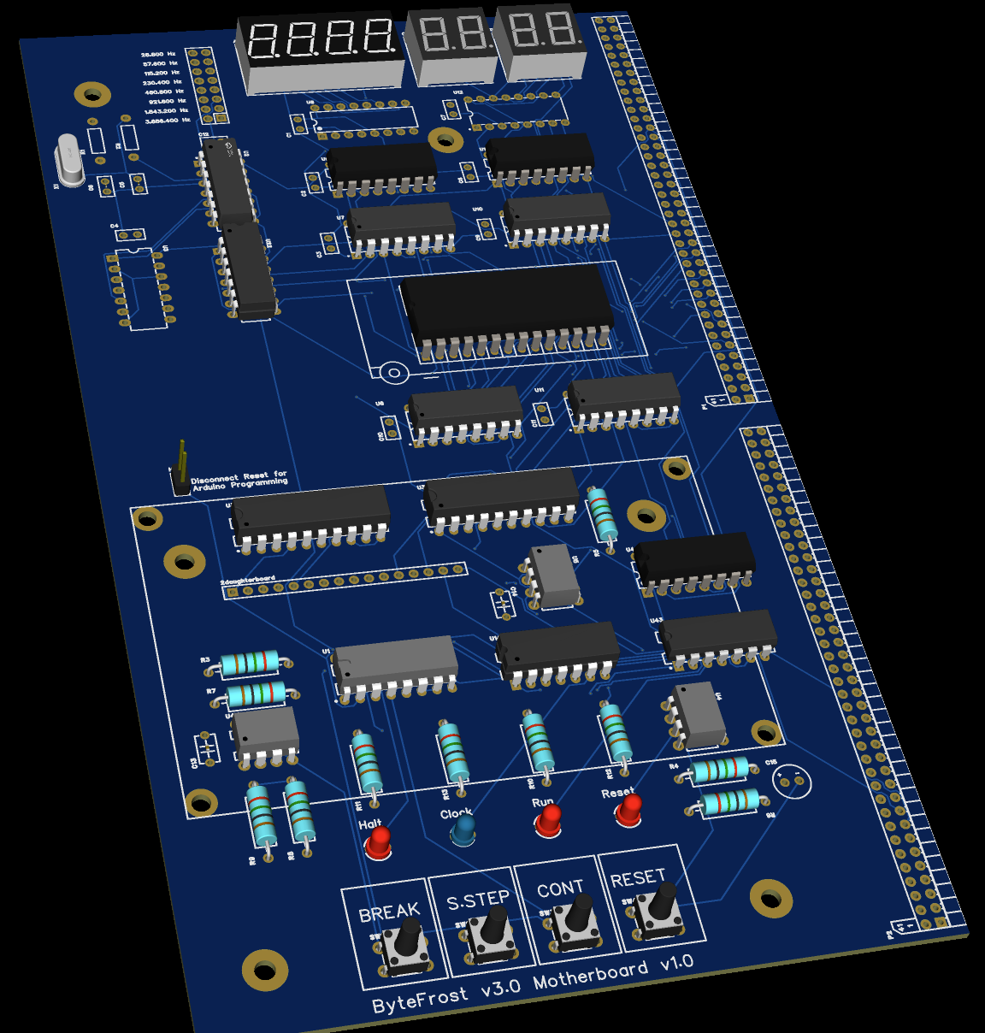
Byte Frost
V3.0 PCB

Slide 2
ByteFrost V3.0 – Migration to PCB
While most of the design is kept from v2.0, the migration to
Backplane and distributed PCB boards impact every circuit.
In addition, all the schematics are real, and not hand made impressions.

Slide 3
Unified Bus Operation (v2.0)
8b→16b
16bitAdder
8 msb
Addr H
Data Bus
Address Bus + Read/Write
8 lsb
Addr L
Data Bus
TmpAR
Data Bus
TmpAR
3msb
AMAP
Decoder
Program Counter
PC
CE
Stack Pointer
EEPROM
SP
Data Pointer
CE
DP
SRAM
Base Pointer
BP
CE
MMIO
AR Select
Read /Write
Instruction Registers
Micro
Instructions
Register
File

Slide 4
ByteFrost Addressing Modes
There are five forms of memory in the ByteFrost – Immediates (read-only), General-Purpose Registers (R0 – R3), Address Registers (DP, SP, PC, BP), Memory (64KB divided into ROM, RAM, and MMIO regions), and Stack
Every solid directed edge (u, v) in the following graph means that memory u can write to memory v with a dedicated instruction.
Every dotted directed edge (u, v) means that the memory u can write to memory v indirectly (i.e., a path exists from u to v but requires multiple instructions to implement).
There are technically 5 x 5 = 25 possible permutations here, but as immediates are read-only, there are in effect only 5 x 4 = 20 possible permutations.
Instructions with an asterisk (*) are currently not implemented.
Immediate
Memory
LDR
MOV
General Register
Address Register
Stack
Src | Dest | Semantics | Dedicated Instruction?
Imm | GR | Rd = Imm_8 (LDR Rd, Imm) | Yes (LDR)
GR | GR | Rd = Rs (MOV Rd, Rs) | Yes (MOV)
AR | GR | Rd = ARSrc[L/H] | Yes (*)
Memory | GR | (LMA) Rd = *{%DP[H], Imm}, DP[L] = Imm (LMR) Rd = *{%DP[H], Rs}, DP[L] = Rs (LMO*) Rd = *(ARSrc + Imm) | Yes (LMA, LMR, *
Stack | GR | Rd = *(SP), SP++ | Yes (POP)
Src | Dest | Semantics | Dedicated Instruction?
Imm | AR | ARDest[L/H] = Imm | Yes (*)
GR | AR | ARDest[L/H] = Rs | Yes (*)
AR | AR | ARDest = ARSrc + Imm | Yes (*)
Memory | AR | ARDest[L/H] = *(ARSrc + Imm) (?) ARDest = *{ARSrc + Imm + 1, ARSrc + Imm} (?) | No
Stack | AR | ARDest = *{SP + 1, SP}, SP += 2 (?) (e.g. POP ARDest) | No
Src | Dest | Semantics | Dedicated Instruction?
Imm | Memory | *(ARSrc) = Imm (?) | No
GR | Memory | *(ARSrc + Imm) = Rs | Yes (*)
AR | Memory | *(ARDest + Imm + 1, ARDest + Imm) = ARSrc(?) | No
Memory | Memory | *(ARDest + Imm) = *(ARSrc) | No (load-store architecture)
Stack | Memory | *(ARSrc + Imm) = *SP, SP++ (?) | No
Src | Dest | Semantics | Dedicated Instruction?
Imm | Stack | *(SP) = Imm, SP– (Push Imm) | No?
GR | Stack | *(SP) = Rs, SP-- | Yes (PUSH *) (change to full-descending)
AR | Stack | *(SP, SP – 1) = ARSrc, SP -= 2 | No? (Push ARSrc)
Memory | Stack | ? | ?
Stack | Stack | ? | ?

Slide 5
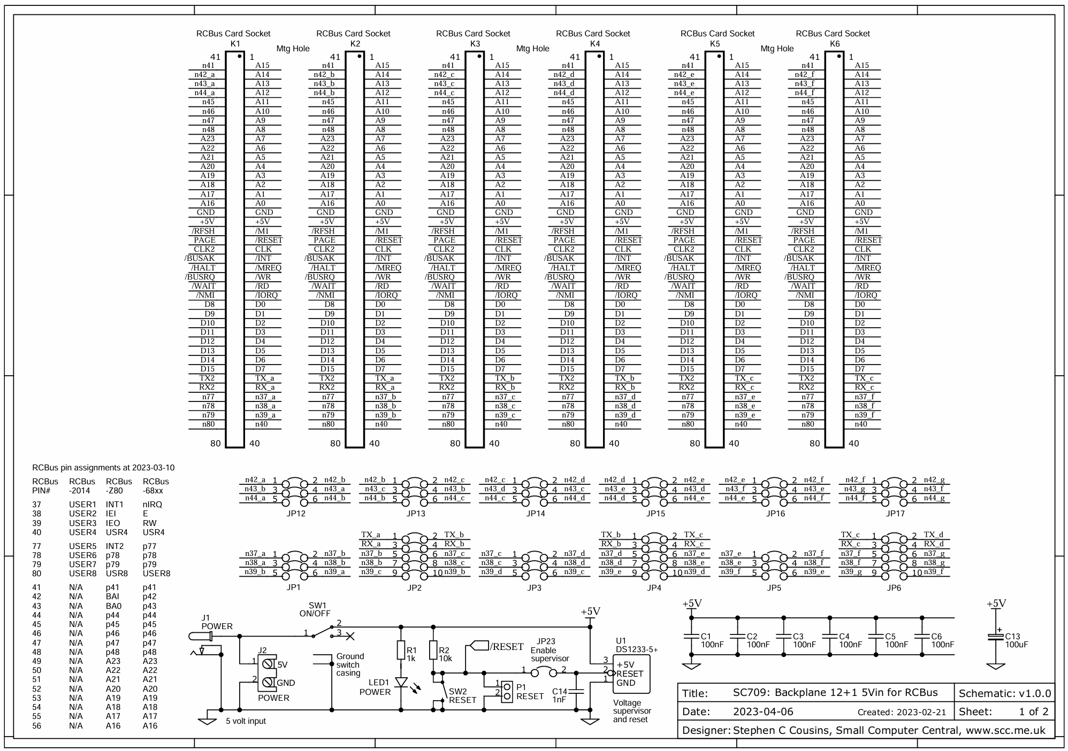
Backplane
42
43
44
42
43
44
37
38
39
37
38
39
sc709_v1.0.0_2023-04-17_22-11_schematic.pdf
EasyEDA(Standard) - A Simple and Powerful Electronic Circuit Design Tool

Slide 6
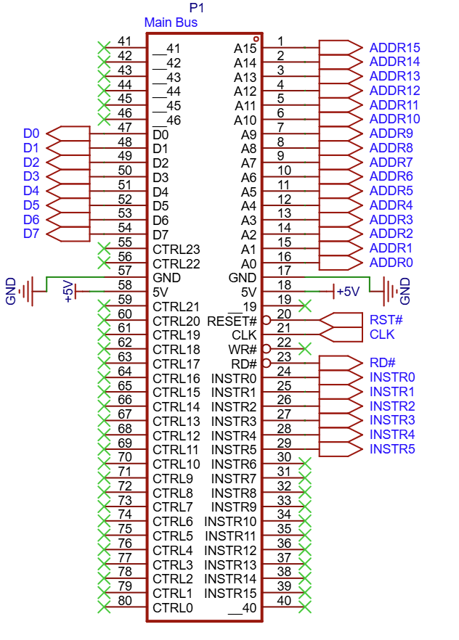
Main Backplane
__41 | 41 | 1 | A15
__42 | 42 | 2 | A14
__43 | 43 | 3 | A13
__44 | 44 | 4 | A12
__45 | 45 | 5 | A11
__46 | 46 | 6 | A10
D0 | 47 | 7 | A9
D1 | 48 | 8 | A8
D2 | 49 | 9 | A7
D3 | 50 | 10 | A6
D4 | 51 | 11 | A5
D5 | 52 | 12 | A4
D6 | 53 | 13 | A3
D7 | 54 | 14 | A2
CTRL23 | 55 | 15 | A1
CTRL22 | 56 | 16 | A0
GND | 57 | 17 | GND
+5V | 58 | 18 | +5V
CTRL21 | 59 | 19 | __19
CTRL20 | 60 | 20 | Reset#
CTRL19 | 61 | 21 | CLK
CTRL18 | 62 | 22 | WR#
CTRL17 | 63 | 23 | RD# (OE#)
CTRL16 | 64 | 24 | INSTR0
CTRL15 | 65 | 25 | INSTR1
CTRL14 | 66 | 26 | INSTR2
CTRL13 | 67 | 27 | INSTR3
CTRL12 | 68 | 28 | INSTR4
CTRL11 | 69 | 29 | INSTR5
CTRL10 | 70 | 30 | INSTR6
CTRL9 | 71 | 31 | INSTR7
CTRL8 | 72 | 32 | INSTR8
CTRL7 | 73 | 33 | INSTR9
CTRL6 | 74 | 34 | INSTR10
CTRL5 | 75 | 35 | INSTR11
CTRL4 | 76 | 36 | INSTR12
CTRL3 | 77 | 37 | INSTR13
CTRL2 | 78 | 38 | INSTR14
CTRL1 | 79 | 39 | INSTR15
CTRL0 | 80 | 40 | __40
Orange pins have jumpers that can make them local
Pin with prefix __ are not assigned

Slide 7
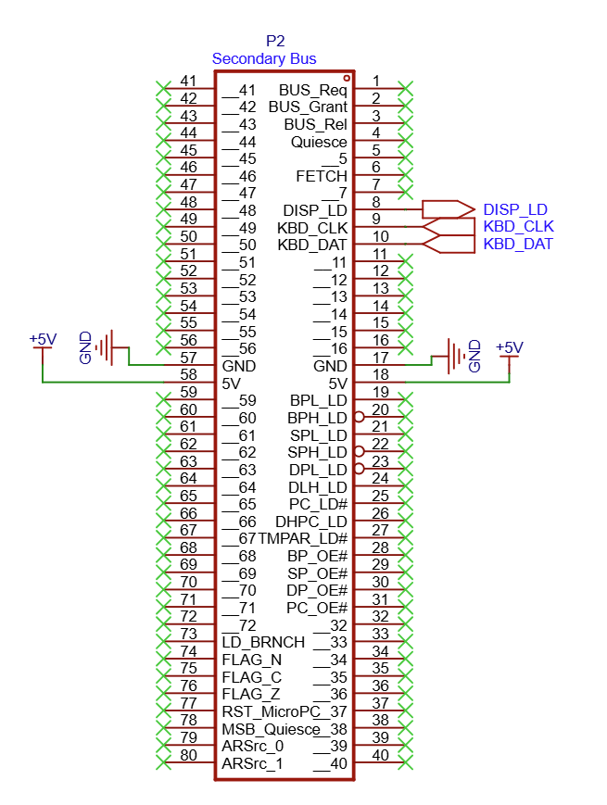
Secondary Backplane
__41 | 41 | 1 | Bus_Request
__42 | 42 | 2 | Bus_Grant
__43 | 43 | 3 | Bus_Release
__44 | 44 | 4 | Quiesce
__45 | 45 | 5
__46 | 46 | 6 | Fetch_Cycle
 | 47 | 7
 | 48 | 8 | Display_Load
 | 49 | 9 | KBD_CLK
 | 50 | 10 | KBD_Data
 | 51 | 11
 | 52 | 12
 | 53 | 13
 | 54 | 14
 | 55 | 15
 | 56 | 16
GND | 57 | 17 | GND
+5V | 58 | 18 | +5V
 | 59 | 19 | BPL_LD
 | 60 | 20 | BPH_LD
 | 61 | 21 | SPL_LD
 | 62 | 22 | SPH_LD
 | 63 | 23 | DPL_LD
 | 64 | 24 | DPH_LD
 | 65 | 25 | PC_LD#
 | 66 | 26 | DHPC_LD
 | 67 | 27 | TmpAR_OE#
 | 68 | 28 | BP_OE#
 | 69 | 29 | SP_OE#
 | 70 | 30 | DP_OE#
 | 71 | 31 | PC_OE#
 | 72 | 32 | __32
LD_BRNCH | 73 | 33 | __33
FLAG_N | 74 | 34 | __34
FLAG_C | 75 | 35 | __35
FLAG_Z | 76 | 36 | __36
RST_MicroPC | 77 | 37 | __37
MSB_Quiesce | 78 | 38 | __38
ARSrc_0 | 79 | 39 | __39
ARSrc_1 | 80 | 40 | __40
Orange pins have jumpers that can make them local
Pin with prefix __ are not assigned

Slide 8
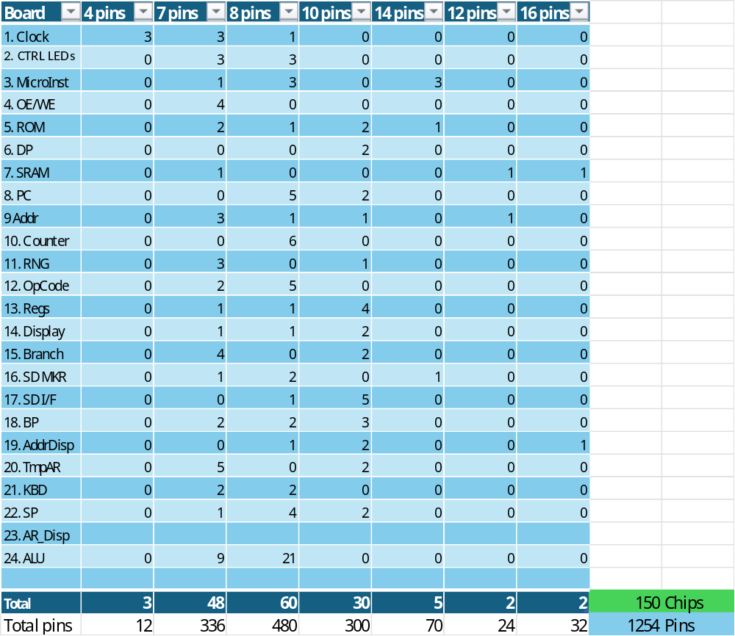
Area Estimation – Chips * Length
23. Arduino+ Display
24. ALU
12. OpCode
13. Regs
1. clock
2. CTRL LEDs
3. MicroInst
4. OE/WE
5. ROM
6. DP
7. SRAM
8. PC
9 Addr
10. Counter
11. RNG
15. Branch | 14. Display
21. KBD
22. SP
16. SD MKR
17. SD I/F
18. BP
19. AddrDisp
20. TmpAR

Slide 9
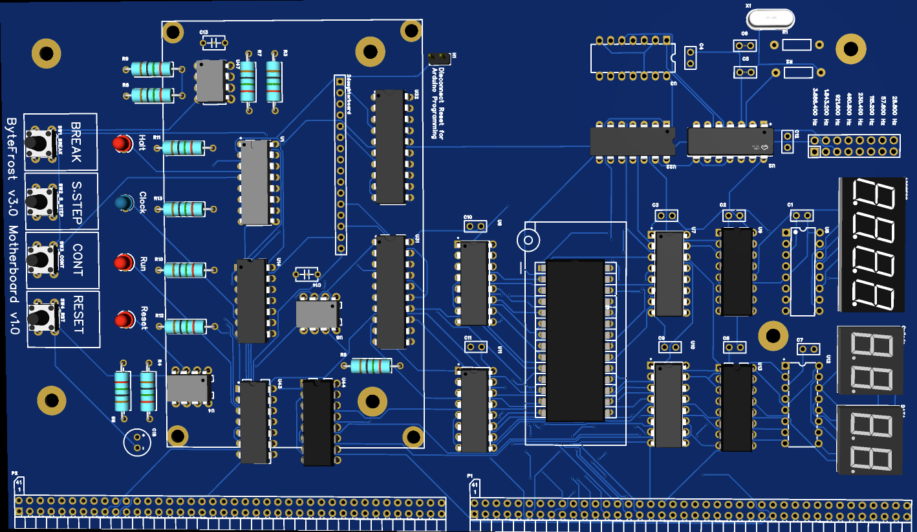
Motherboard
(v3.0)
The 4 buttons and LEDs at the bottom preserve the
original ByteFrost design
The clock is replaced with a crystal.
The clock control is through the jumpers next to the crystal
The 7SEG displays are scanned, such that one decoder
serves 4 digits.
The Display is planned to stand on 45mm columns
16b rainbow need to connect the display to the motherboard
The empty space is to allow easy access to the EEPROM
release bar
The Primary and Secondary busses provides 160 lines to the
rest of the system

Slide 10
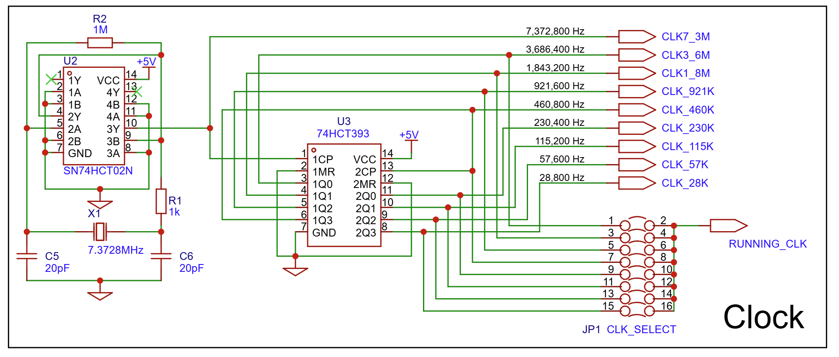
Motherboard
Clock (v3.0)

Slide 11
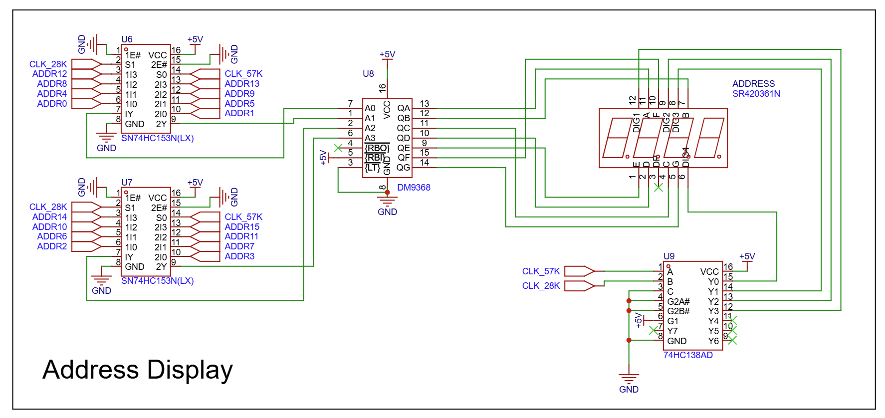
Motherboard
Address Display
(v3.0)

Slide 12
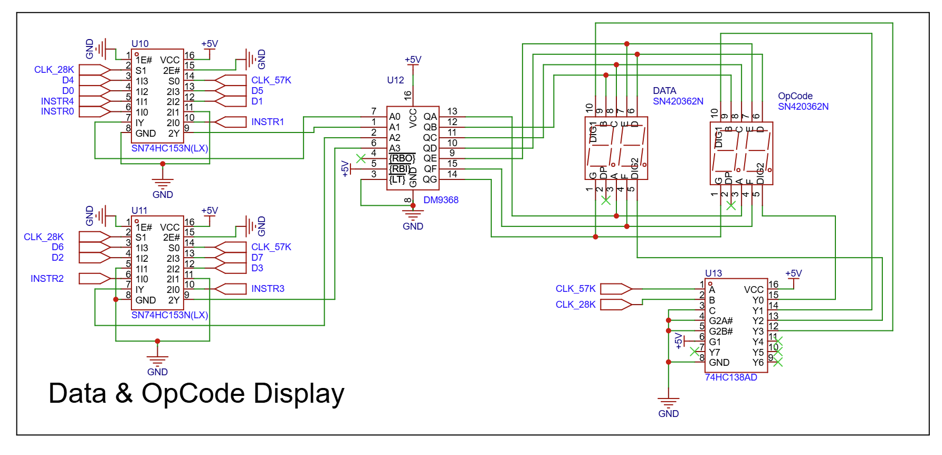
Motherboard
Data and Opcode Display
(v3.0)

Slide 13
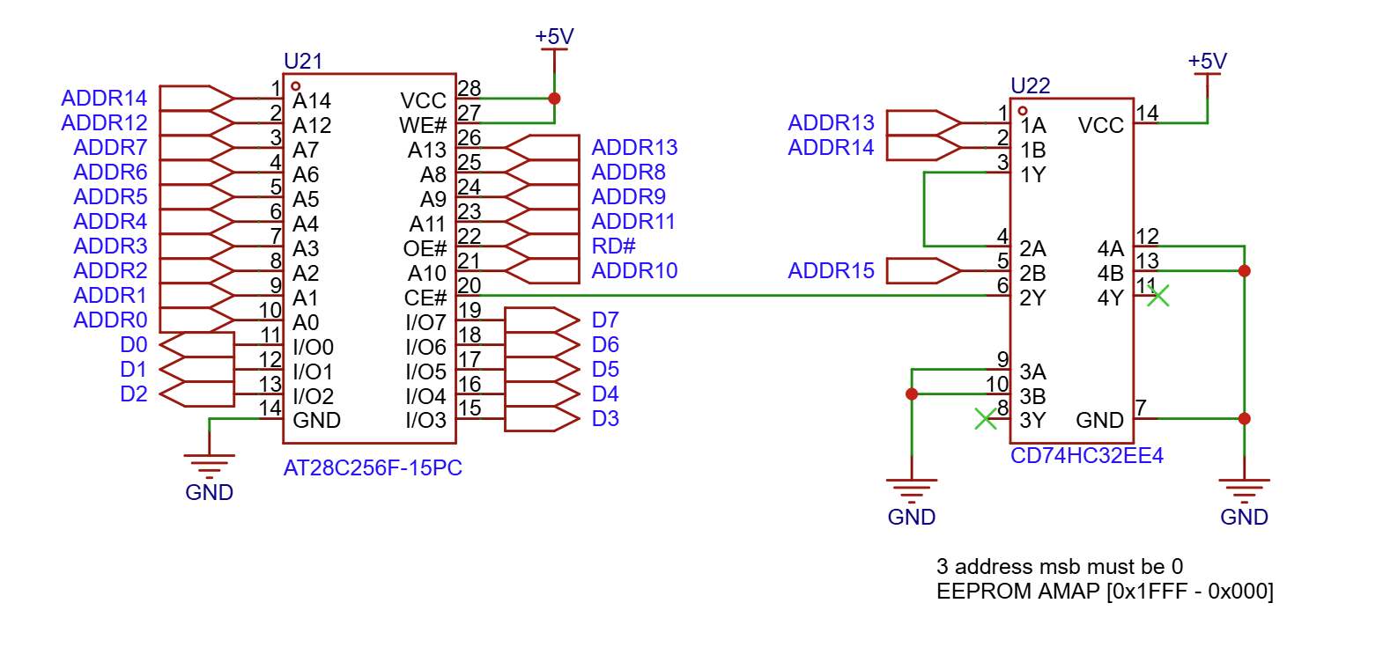
Motherboard
EEPROM (v3.0)
In v3.0, the Chip_Enable signals are distributed,
i.e, each storage need to generate its own CE
based on the address bus.
In this case the three MSBs are OR-ed to generate
CE# for the lower 8KB

Slide 14
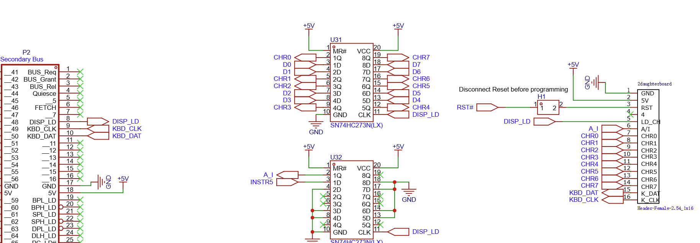
Motherboard
Arduino Interface
(v3.0)
DISP_LD – trigger printing a CHAR on the display
First 273 capture the CHAR and second captures the A/I
LDISP_LD also goes to the Arduino to trigger interrupt
The Keyboard CHAR is serialized from Arduino and processed elsewhere through the secondary backplane.
The reset line to Arduino need to be disconnected
to enable programming through the USB

Slide 15
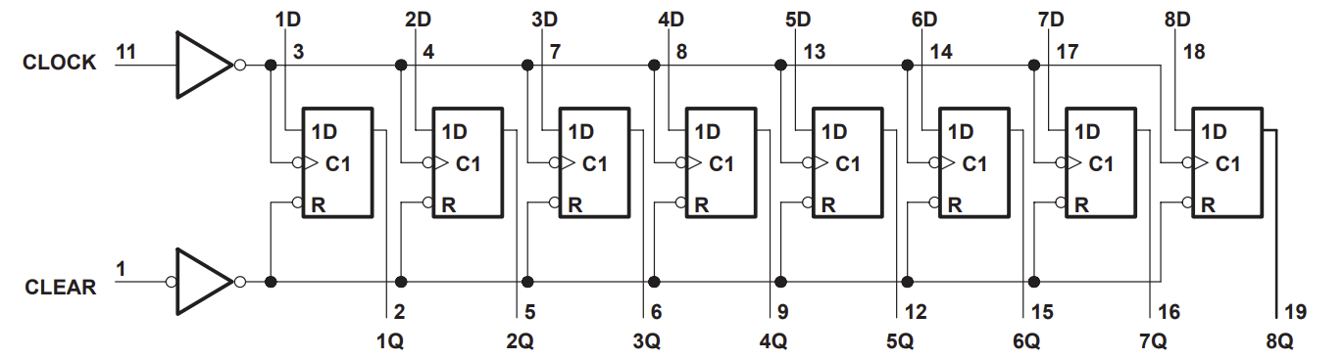
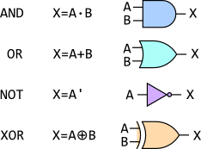
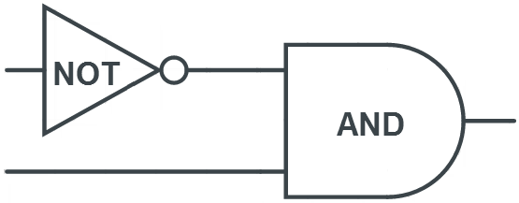

Display Load (V2.0)
Data Bus
273 Char
Disp Char
µC 6: Out Reg H
µC 3: Reg Out Select
Display Load
OpCode_08
A/I
OpCode [5] A/I
273 A/I
OpCode_0D
Main CLK
15

Slide 16
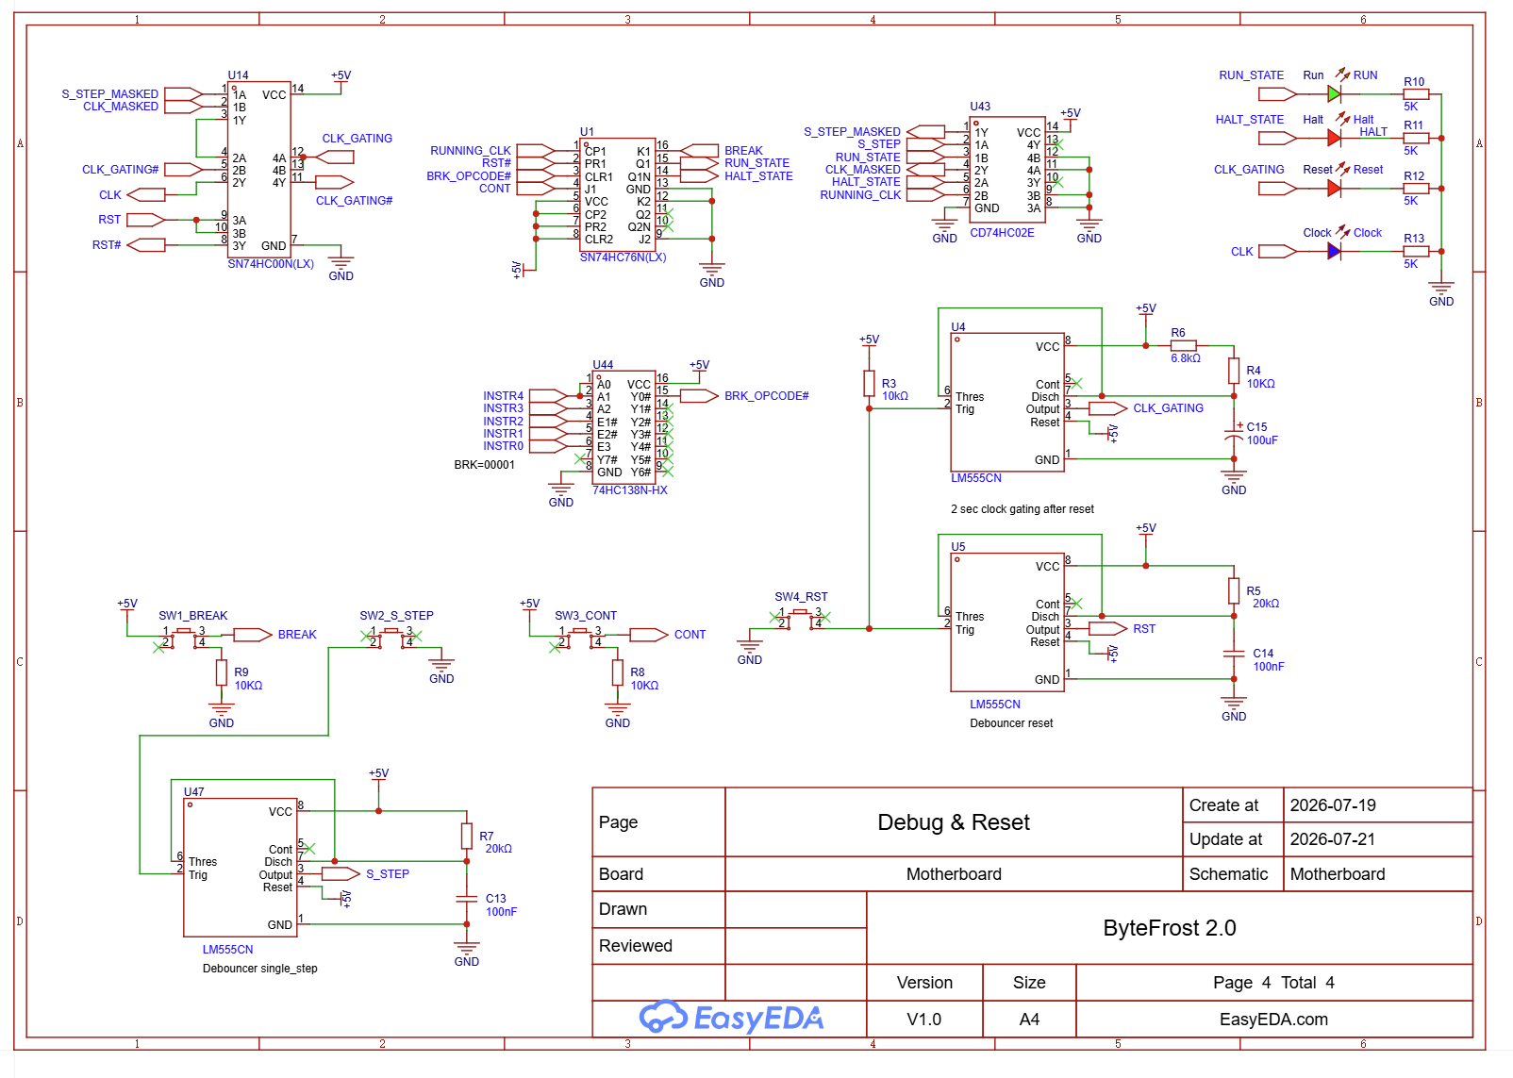
Debug & Reset (v3.0)
The LM555 one-shots are used as debouncers,
i.e. unify the many fast transitions a button may create.
E.g. a “Single Step” button may advance multiple addresses unless a debouncer will unify the transitions into a single press.
The CLK_GATING is a special timer that extend RST to almost 2sec. This allows the Arduino handling the display sufficient time. Otherwise, the first characters that printed in that time will be lost.
74HC76 is the running-state FF which determines if the system is:
  RUN_STATE: RUNNING_CLK becomes CLK
  HALT_STATE: No clock, or S_STEP is the CLK
The BREAK and CONT do not need debouncers as they
reset or set running-state
74HC02 is an OR
The State wires are ORed with the clock they mask.
(The output of the OR is ‘1’ instead of clock)
74HC00 is a NAND
The two masked clocks are combined with a NAND
(the masked clock is 1, enabling the other to go through the NAND)
Another NAND is gated to allow the 2sec for the Display
Next slide from v2.0 might help to visualize this

Slide 17
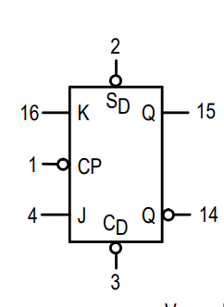
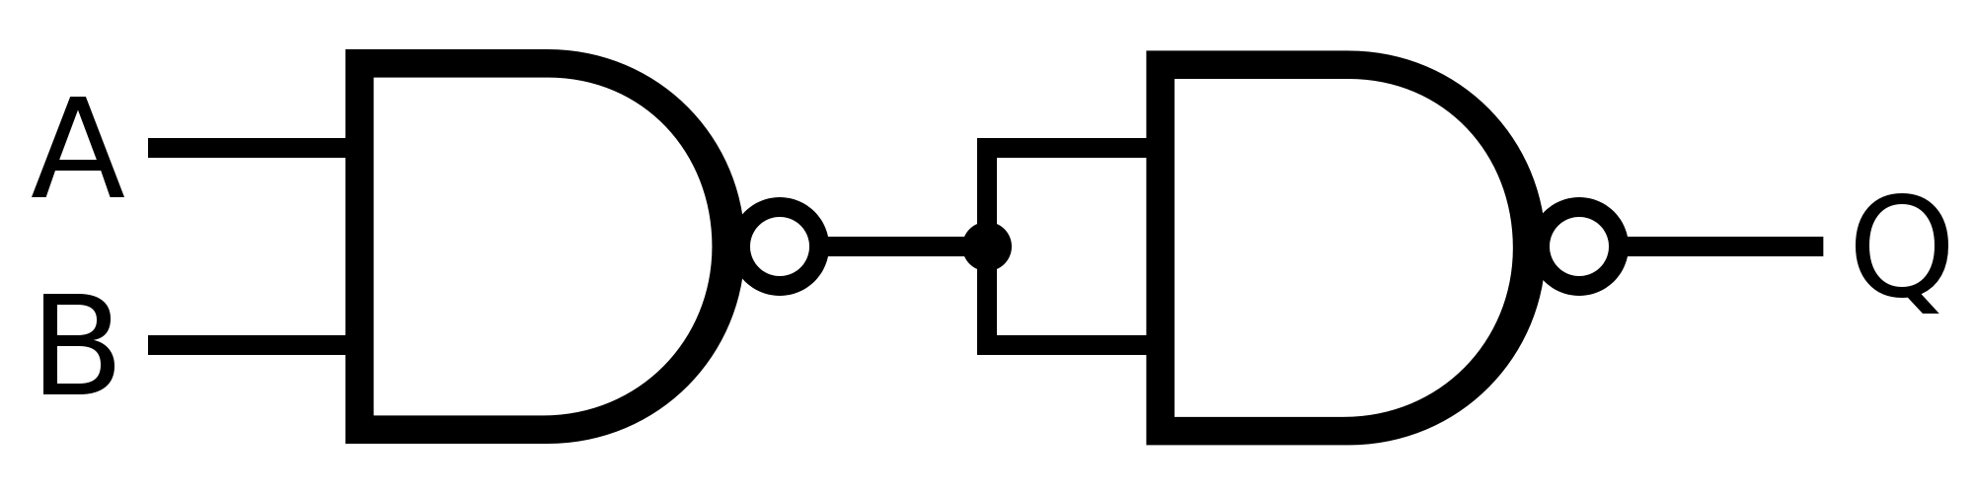
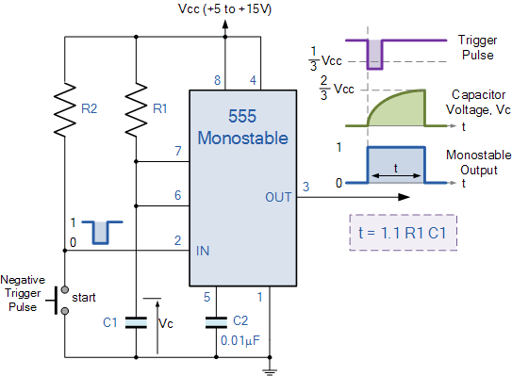
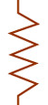
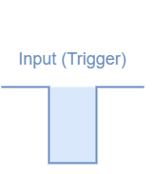
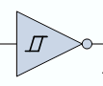

Clock Gating (v2.0)
S.S. CLK
Reset#
BRK Button
(Purple)
74LS76
RUN LED
(Brown wire)
Running CLK
Clock LED
(Green wire)
Cont. Button
(Gray)
Halt LED
(Blue wire)
Main CLK
Clock gating 2sec for
Arduino (display) to boot
Op Code 1: BRK
Running CLK
Reset Button
(Red wire)
Main Reset
Reset
Reset LED
(Orange wire)
2s
17
4ms

Slide 18
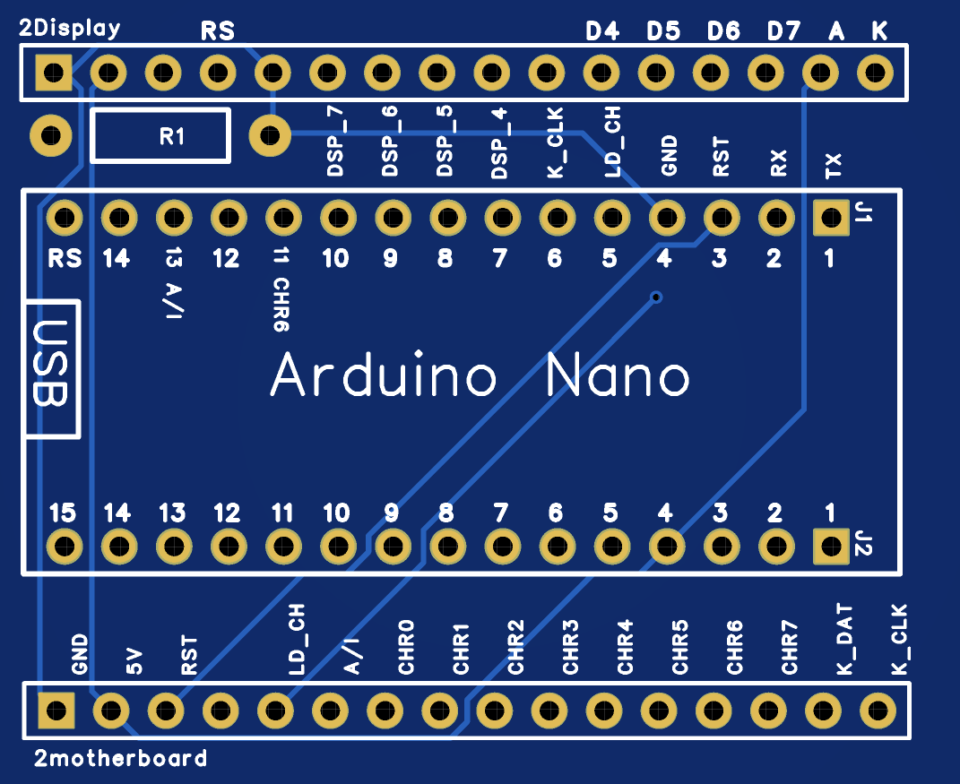
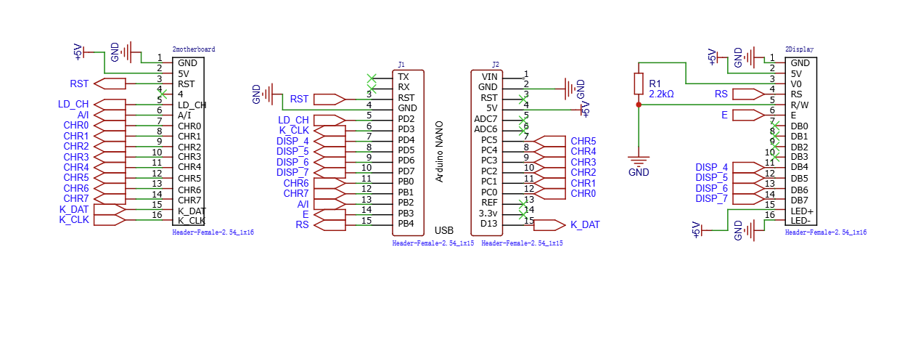
Display Daughterboard (v3.0)
The Display daughterboard is a mapper between the ByteFrost, the Arduino and the Display
The wire to the motherboard is a 16-wire rainbow to the Motherboard
J1/J2 are the socket for the Arduino
The socket to the display is directly mapped to the display and physically holds the daughterboard in the air underneath the display.
The Arduino is positioned such that the USB socket is as close as possible to the left edge of the Display, on the far end from the backplane of the Motherboard

Slide 19
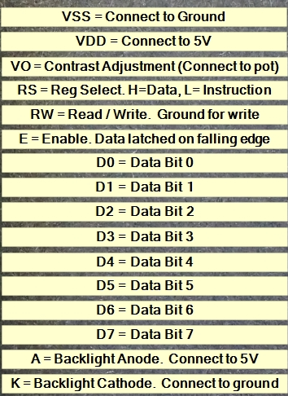

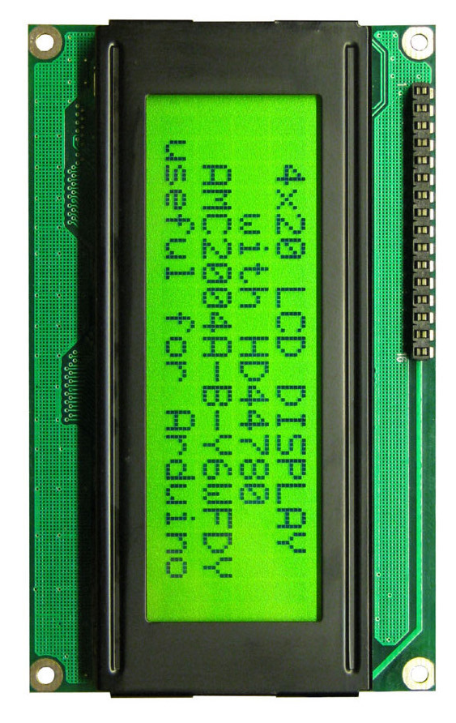
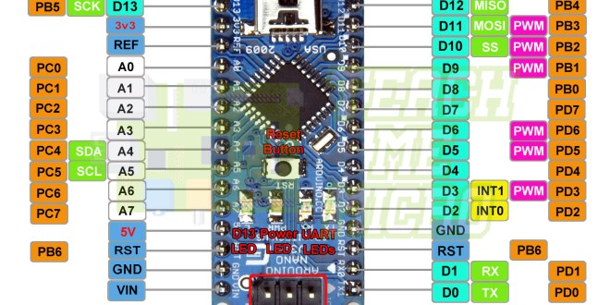
Display (V2.0)
Disp Char
5 4 3 2 1 0
6 7
# Main Reset
White
5V
Gray
KBD
KBD clock
KBD data
USB Serial.Print
INT0
A/I
Notes:
To free up 4 GPIOs, Display is configured to use 4b which requires two writes
5v was added to allow independence of USB connection.
When USB is connected, it helps the main supply
To enable programing, the reset line need to be disconnected
– proposed to add a 3state on its path
“A/I” is now latched and stay valid for multiple clocks and does not fail at MAX clock
IDE Setup: Board "Arduino NANO“; CPU "ATmega328p (old bootloader)"
Display Load
19
Notes:
1. IDE Setup
a. Board "Arduino NANO"
b. CPU "ATmega328p (old bootloader)"
2. To program the Arduino - the RESET control signal (black) need to be disconnected!!.

Slide 20
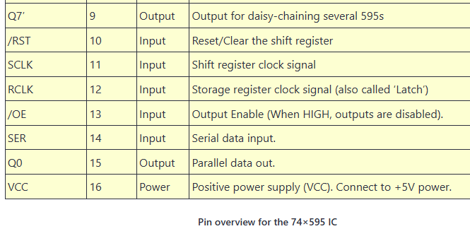
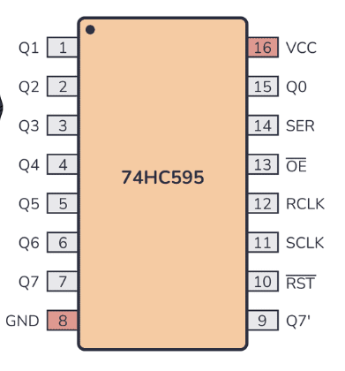
Keyboard
KBD #OE
12
11
13
#Ready
9
8
“1”
RDY
1
12
13
3
2
1
2
Notes:
The format of the character is 1 READY bit followed by 8b char
Once the READY bit reaches the 9th spot (RDY Q0) the Char is ready
Once Ready, the Read to KBD generate #OE and the Char is out
If there is no Char, the #OE does not happen, and the CPU read 0
CPU ignores 0 as it is not an ASCII
The #OE also generates a reset that empty the SR but not the register
The end of the #OE generates a Reg clk (RCL), to load 0 to the register
The clock of the SR is inversed as clock to the Register (RCL)
(if not inverted, the register get the previous SR)
The RCL combines both clock and #OE through OR 123
It is important that the clock from the display is 0 when not active
so it wont block the OR.
Data Bus
Data - Gray
Clock - White
KBD
KBD

Slide 21
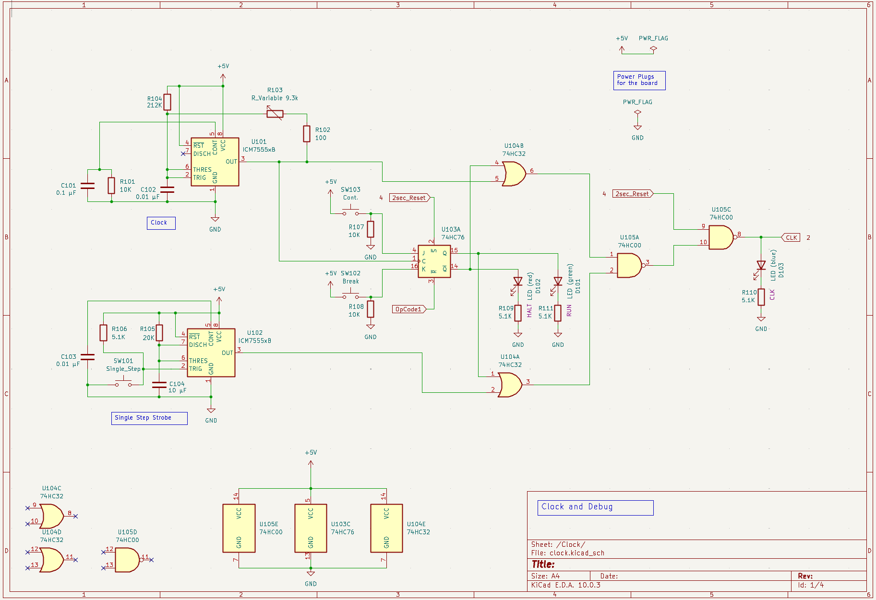
Clock and Debug

Slide 22
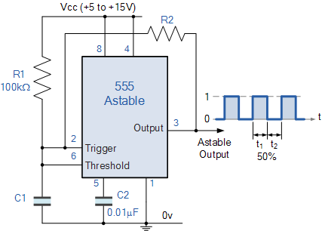
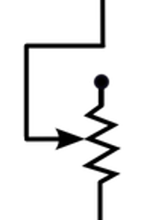

Clock
Parts | Min | Frequency
0.01uF (103) | 5KHz | 420KHz
R2=100
Rpin5=10K
100Ω
9.3kΩ
220
6
Running CLK
R on pin 5:
The design of using Vout as power for charging C1 generates 50% duty cycle only if Vout==Vcc. In reality, it is lower and the capacitor takes more time to reach the higher trigger point and duty cycle without it is only 33%.
With 10K on pin 5, both triggering points become lower, closer to 1/3 and 2/3 of Vout (instead of Vcc). That provides 50% duty cicle,also increase the frequency because the distance between the points is smaller (increasing the max frequency of this design from 250hHz to 420kHz)
10KΩ
2
0.1uF
Or
10uF
S.S. CLK
Single Step
(Yellow wire)
22

Slide 23
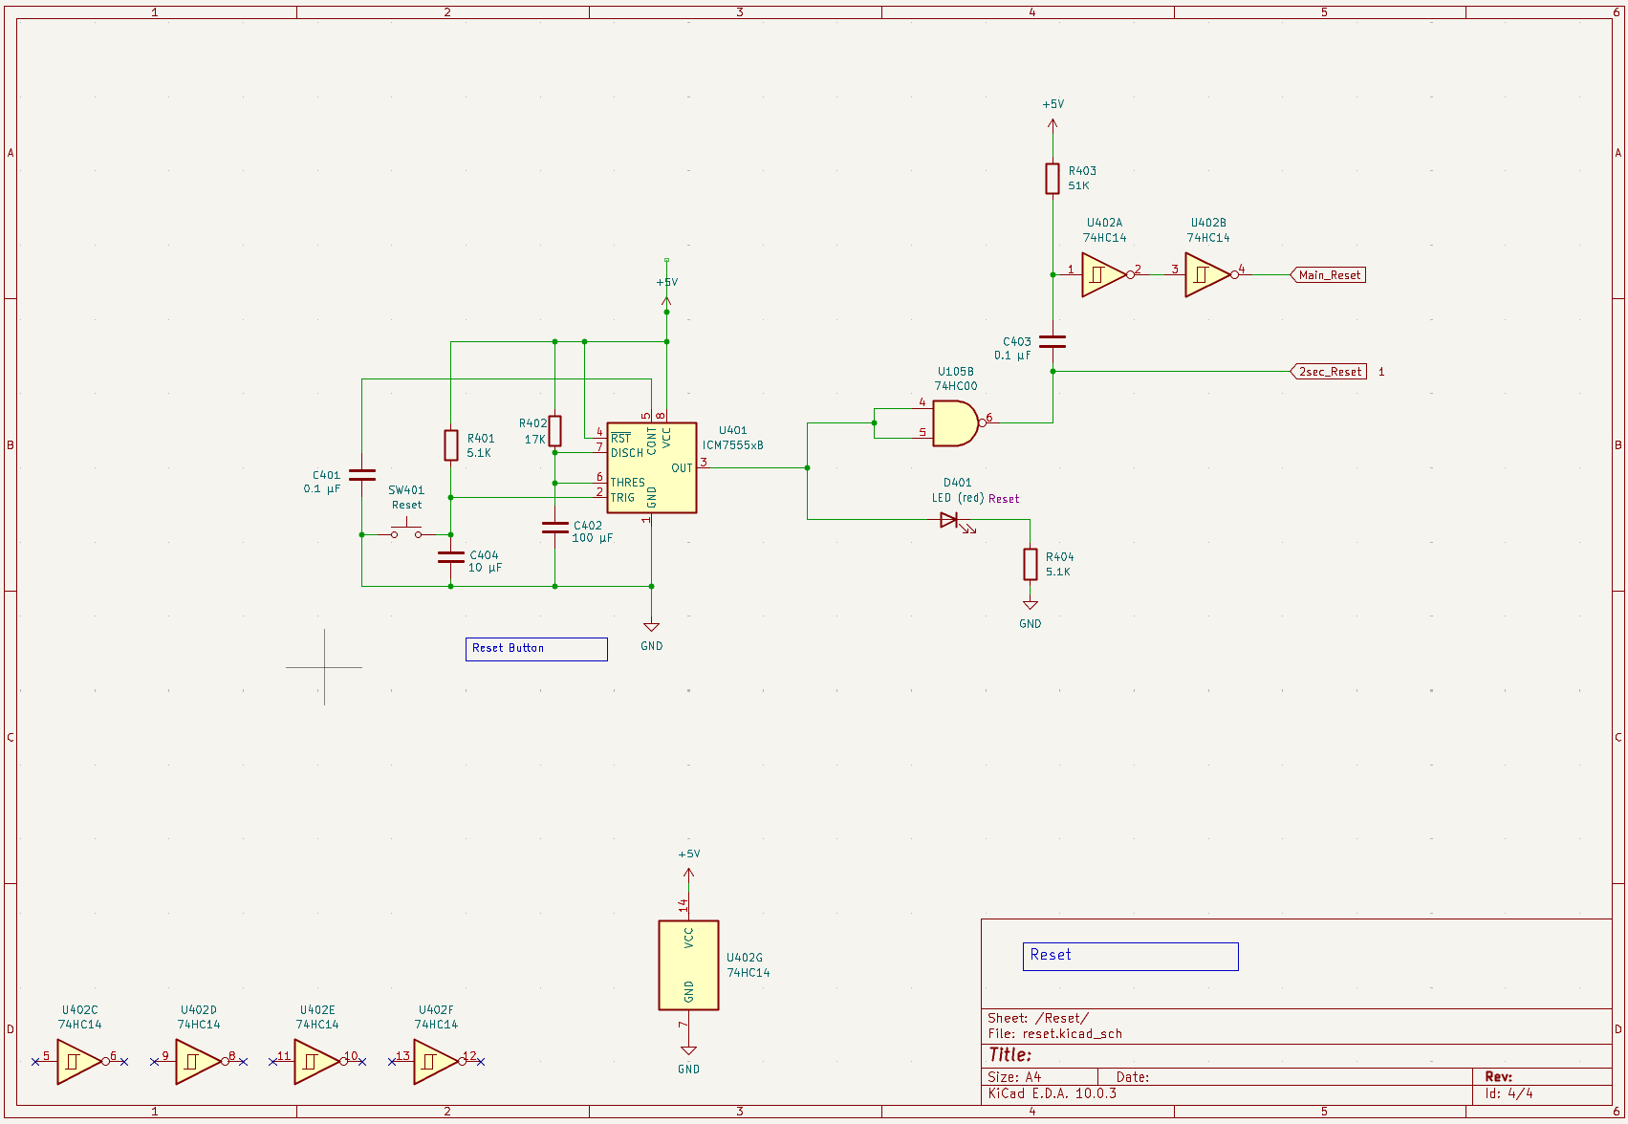
Reset

Slide 24
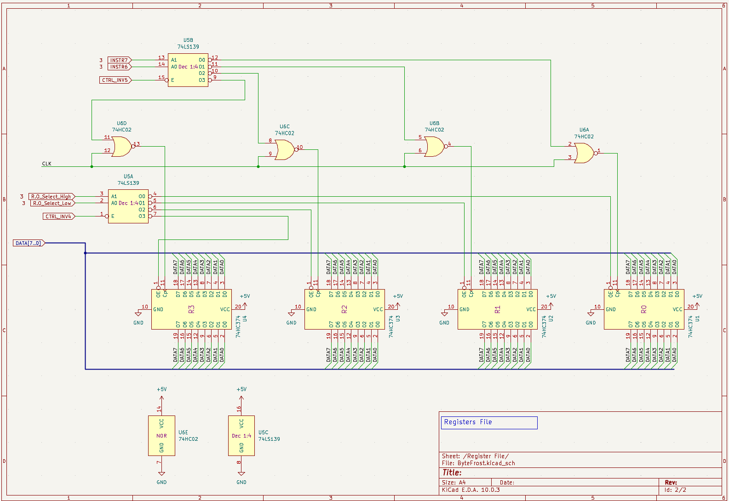
Registers File

Slide 25
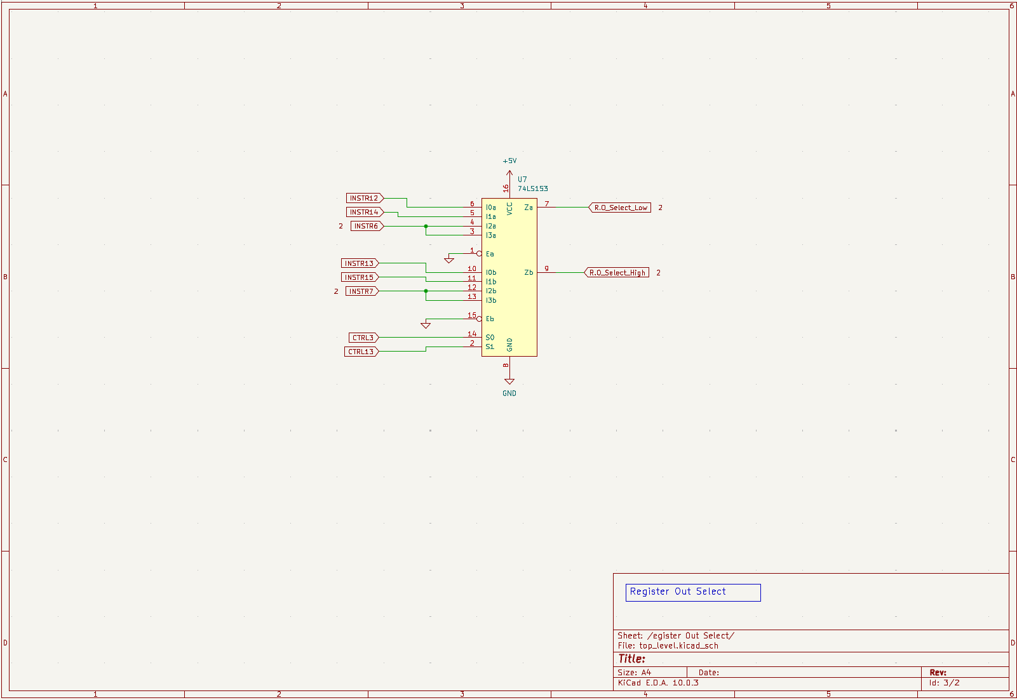
Register Out
Select

Slide 26
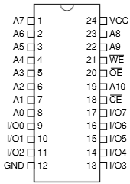
Address Bus Select (ARSelect) v2.0
ARSelect specifies which AR gets to write to the Address Bus and whether any of them do (it can do this since it only sends output enables; if it doesn’t send an output enable to any hardware entity, then no entity writes to the address bus).
Bus Grant
FetchCycle
µC 9: PC Out
µC 14: SP Out
TmpAR OE
µC 20: TmpARWrite
ARSelect 8x8 LUT
Opcode_MAG_LDW_SDW_MAA
ARSrc [1:0]
Base Pointer OE
Program Counter OE
Data Pointer OE
Stack Pointer OE
Inputs |  |  |  |  |  |  | Outputs (Active Low)
Bus Grant (A7) | Fetch Cycle (A6) | PC Out control signal (A5) | SP Out control signal (A4) | TmpAR Write control signal (A3) | Opcode_MAG_LDW_SDW_MAA (Active Low) (A2) | AR Src operand (A1, A0)
1 | X | X | X | X | X | X | None (Bus floats)
0 | 1 | X | X | X | X | X | PC (I/O 0)
0 | 0 | 1 | X | X | X | X | PC (I/O 0)
0 | 0 | 0 | 1 | X | X | X | SP (I/O 2)
0 | 0 | 0 | 0 | 1 | X | X | TmpAR (I/O 4)
0 | 0 | 0 | 0 | 0 | MAG, LDW, SDW, MAA | AR Src[1:0] | = AR Src[1:0] 0-PC, 1-DP, 2-SP, 3-BP
0 | 0 | 0 | 0 | 0 | Other Opcodes | X | DP (I/O 0)
EEPROM Data Output Bit | Output
7 | 1 (unused)
6 | 1 (unused)
5 | 1 (unused)
4 | TmpAR Output Enable (ACTIVE LOW)
3 | BP Output Enable (ACTIVE LOW)
2 | SP Output Enable (ACTIVE LOW)
1 | DP Output Enable (ACTIVE LOW)
0 | PC Output Enable (ACTIVE LOW)

Slide 27
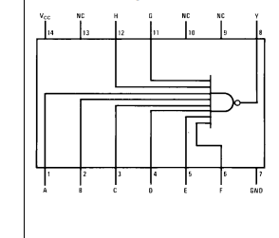
Opcode_MAG_LDW_SDW_MAA (v2.0)
LDWL
OpCode_14
LDWH
OpCode_15
74LS30
SDWL
OpCode_16
SDWH
OpCode_17
MAAL
OpCode_18
Opcode_MAG_LDW_SDW_MAA
MAAH
OpCode_19
MAG
OpCode_1A
Opcode_MAA
JSR
OpCode_10
Opcode_MAA_JSR

Slide 28
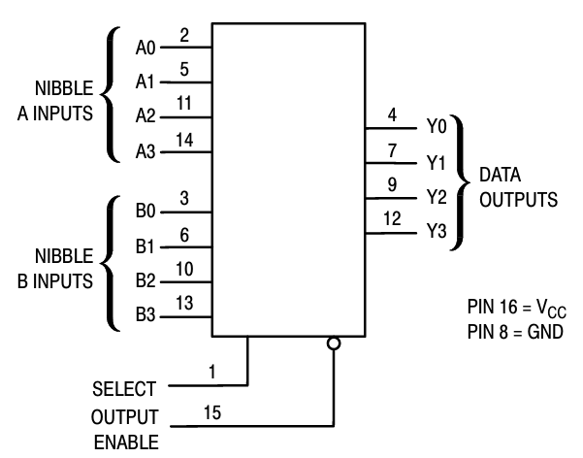
ARSrc Operand Decode v2.0
Instr[5],Instr[1]
Instr[9],Instr[8]
ARSrc Decode:
If opcode is of (AR → GR) (Rd = ARSrc[L/H]) instruction, then ARSrc is in bits 9:8.
Otherwise, ARSrc is a function of bits 5 and the opcode (maybe the opcode’ least significant bit?)
Instructions that specify ARSrc with 1 bit in bit 5 need to get the other bit from the opcode; if we always assign these two-opcode instructions opcodes as [4-bit opcode x][0/1], then we can get the other ARSrc bit from the least significant bit of the opcode, i.e., in these instructions ARSrc is {Instr[5], Instr[0]} (in bits 5 and 0)
Instr[9],Instr[8]
157: ARSrc
ARSrc [1:0]
Instr[5],Instr[1]
OpCode_MAG
0v

Slide 29
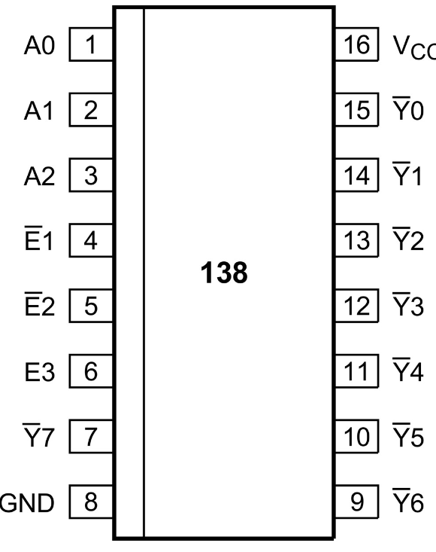
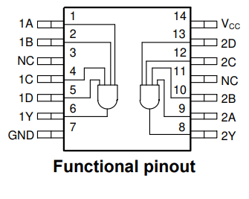
Address Map Decoder (v2.0)
Address Bus + Read/Write
~EEPROM Chip En
A15..A13
Address Map
138 AMAP
138 AMAP
74HC21
0000 – 1FFF | ROM
2000 – 3FFF | RAM
4000 – 5FFF
6000 – 7FFF
8000 – 9FFF
A000 – BFFF
C000 – DFFF
E000 – FFFF | MMIO
~SRAM Chip En
MMIO
E000 – E1FF | SD Card
E200 – E3FF | Counter
E400 – E5FF
E600 – E7FF
E800 – E9FF
EA00 – EBFF
EC00 – EDFF
EE00 – EFFF
F000 – FFFF | No HW
A9
A10
A11
~SD Card Device En
A12
138 MMIO Device Enable
~Counter Device En
74HC21

Slide 30
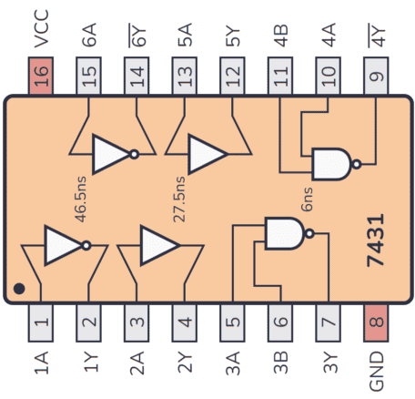
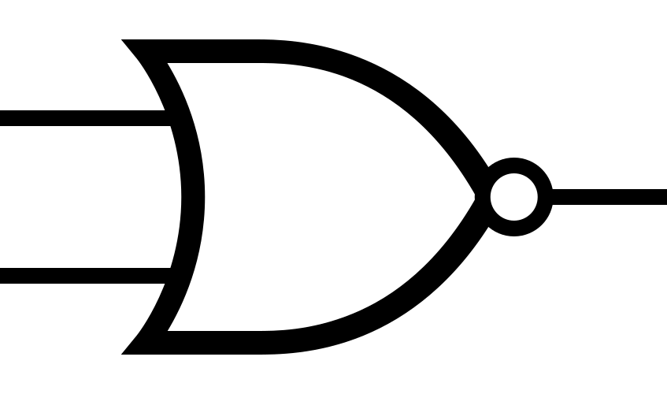
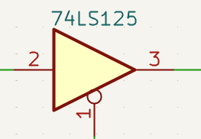
Memory Access (v2.0)
Cycle | Signal | SRAM | EEPROM | MMIO
Memory Write | #WE | #WE | ‘1’ (no writes) | #WE
Memory Read | #OE | #OE
Memory Write, or Memory Read | #CE | (~SRAM Chip En) | (~EEPROM Chip En) | MMIO
148ns delay
OR+Delay postpones the start of #OE,
but doesn’t impact its end
µC 10: MEM Read
FetchCycle
#OE
Main CLK
5
6
#WE
µC 11: MEM Write
4
Bus Grant

Slide 31
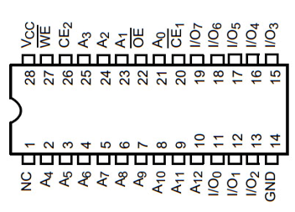
SRAM (v2.0)
Data
Bus
~SRAM Chip En
#OE
#WE
Address Bus + Read/Write
SRAM
A0..A15
I/O[0:7]
31

Slide 32
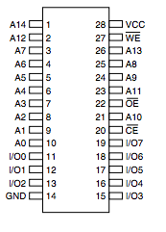
EEPROM (v2.0)
Address Bus
Addr
[15:0]
Prog EEPROM
~EEPROM Chip En
Prog
Data[7:0]
#OE
Data Bus
32

Slide 33
Address Registers - Data Bus Load Enable v2.0
PC Ld Branch
µC 17: LoadAR
µC 8: PC Load
µC 18: LoadAR H/L
Opcode_MAA
BP[H] Ld En
Opcode_5
AR DB LE 8x8 LUT
Opcode_7
BP[L] Ld En
Opcode_6
SP[H] Ld En
SP[L] Ld En
PC Ld En
DP[H] Ld En
Main CLK
DHPC Ld En
DP[L] Ld En
EEPROM Address Bit | Input
7 | PC Ld Branch (Flags & µC 8: PC Load)
6 | loadAR (control signal)
5 | PC Load (control signal)
4 | loadARHorL (control signal)
3 | Opcode_MAA (ACTIVE LOW)
2 | (AR) L/H instruction operand
1 | ARDest[1]
0 | ARDest[0]
EEPROM Data Output Bit | Output
7 | BP[H] Load Enable (574 - ACTIVE HIGH)
6 | BP[L] Load Enable (574 - ACTIVE HIGH)
5 | SP[H] Load Enable (191 – ACTIVE High*)
4 | SP[L] Load Enable (191 - ACTIVE High*)
3 | DP[H] Load Enable (574 - ACTIVE HIGH)
2 | DP[L] Load Enable (574 - ACTIVE HIGH)
1 | DHPC Load Enable (574 - ACTIVE HIGH)
0 | PC[L] Load Enable (161 - ACTIVE LOW)
* 191 is active low, but to use the AND for clock gating they are Active High that later inverted

Slide 34
Program Counter Design
The Program Counter on Address Bus is a 16b pointer, with granularity of bytes.
However, the actual HW counter is a 15b counter, counting instructions.
So:
  When SW writes to the HW counter, the data shift right, dropping the lsb
  (PC cannot be odd)
  When HW Counter writes to the Address bus, it shift left, addith the lsb from the fetch FSM
Load PC from Dummy
Load PC from Data Bus
Load PC from Data+Dummy
15 | 14 | 13 | 12 | 11 | 10 | 9 | 8 | 7 | 6 | 5 | 4 | 3 | 2 | 1 | 0
dangled
0
HW Program Counter
15 | 14 | 13 | 12 | 11 | 10 | 9 | 8 | 7 | 6 | 5 | 4 | 3 | 2 | 1 | 0
dangled
Bit[0] from
Fetch FSM
PC on the Address Bus
15 | 14 | 13 | 12 | 11 | 10 | 9 | 8 | 7 | 6 | 5 | 4 | 3 | 2 | 1 | 0

Slide 35
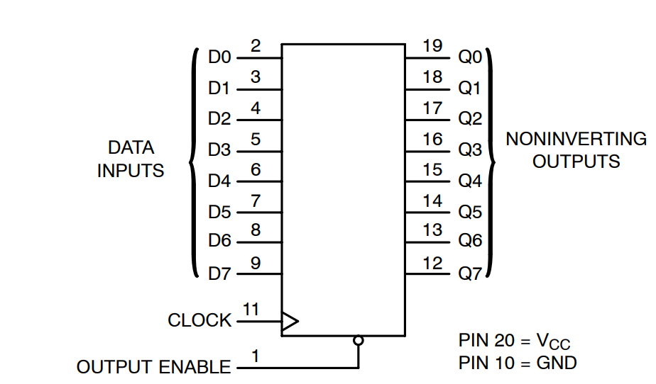
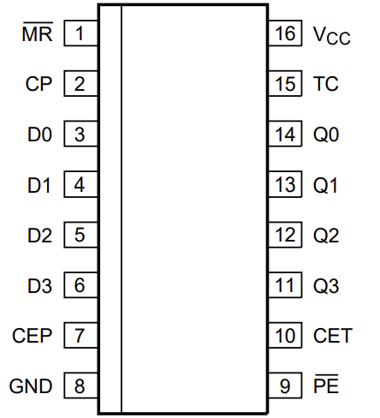
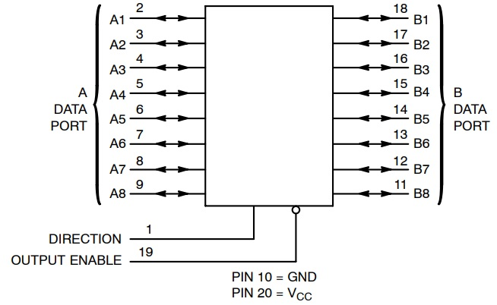
Program Counter (v2.0)
Notes:
In SW view, PC points to Address,
In HW view, PC points to instruction (div by 2)
Read PC : PC shifts left
  “INC Prog Counter” provides bit 0
Write PC: (Absolute Branch, JSR, RTS)
Dummy and Data shifted right (ignoee lsb)
DHPC Ld En
Data Bus
574: Prog Ctr
Dummy
Data
[7:5]
Data
[4:1]
Data[0] dangled
0,[15:9]
Main CLK
‘0’
PC[8]
~Main Reset
74HC161 PC[15:13]
74HC161 PC[12:9]
74HC161 PC[8:5]
74HC161 PC[4:1]
Address Bus
PC
[8:5]
PC
[4:1]
PC Ld En
PC High[15:9]
PC Low[8:1]
INC Prog Counter
[0]
74HC245
74HC245
PC[14:8] → Addr[15:9]
INC → Addr[0]
PC[7:0 ]→ Addr[8:1]
Addr Hi
[15:9, 0]
Addr Low
[8:1]
Program Counter OE
35

Slide 36
Data Pointer (v2.0)
Address Bus + Read/Write
Data
Bus
A15..A8
A15..A8
574: Addr Ptr Hi
DP[H] Ld En
A7..A0
574: Addr Ptr Lo
A7..A0
DP[L] Ld En
Data Pointer OE
Clk
!Clk
Control
AND
36
Data is sampled in the middle of the clock (negative edge)

Slide 37
Base Pointer (v2.0)
Address Bus + Read/Write
Data
Bus
A15..A8
A15..A8
574: Addr Ptr Hi
BP[H] Ld En
A7..A0
574: Addr Ptr Lo
A7..A0
BP[L] Ld En
Base Pointer OE
Clk
!Clk
Control
AND
37
Data is sampled in the middle of the clock (negative edge)

Slide 38
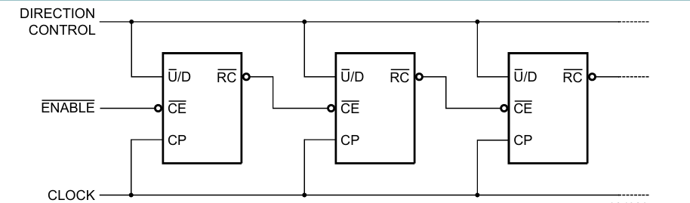
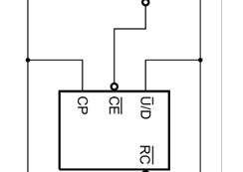
Stack Pointer (v2.0)
µC 16: SP Up/Down
µC 15: SP Count
Main CLK
Address Bus + Read/Write
SP[H] Ld En
74HC191
A3:A0
A3..A0
574: Stack Ptr Page
A7..A0
Data
Bus
SP 3:0
SP 7:4
A7..A4
74HC191
A7:A4
A11..A8
A15..A8
SP 3:0
74HC191
A11:A8
574: Stack Ptr Page
SP 7:4
A15..A12
74HC191
A15:A12
SP[L] Ld En
Stack Pointer OE
38

Slide 39
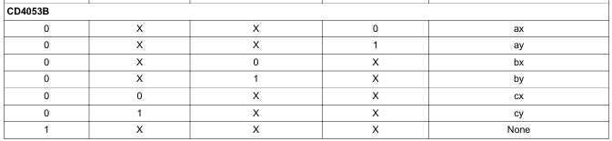




Address to Data Bus
Data Bus
Data
[7:0]
Address Bus
Data
[7:0]
Main CLK
9
10
8
Bock clock during Output Enable
574: Addr Hi
574: Addr Lo
µC 21: AB2DB
Addr Hi
[15:8]
Addr Hi
[15:8]
µC 21: AB2DB
5v
1v
Addr Lo OE
1v
11
13
Addr Hi OE
AR H/L (Instr[5])
12
µC 21: AB2DB
µC 22: AB2DB H/L
Opcode_MAA_JSR
1
3
0
0v
CD4053 C
Opcode_MAA_JSR
11
4
Addr Hi OE
12
5
1
0v
µC 22: AB2DB H/L
0
0v
CD4053 A
9
14
AR H/L (Instr[5])
13
1
10
1
0
CD4053 B
15
Addr Lo OE
1
2
1

Slide 40

TmpAR (Address Offset Adder) v2.0
Address Bus
Main CLK
5
6
Addr Hi
[15:8]
Addr Low
[7:0]
1
3
2
Read in the middle of the cycle
574: TmpAR Hi
574: TmpAR Lo
Addr Hi
[15:8]
Addr Hi
[15:8]
µC 19: TmpARRead
Address Bus
TmpAR OE
283: Add 3:0
283: Add 3:0
283: Add 3:0
283: Add 3:0
Data
Sign Extended
[15:8]
Data
[7:0]
Addr Hi
[15:8]
Addr Lo
[7:0]
Data Bus

Slide 41
Output H Register to Data Bus (v2.0)
Data
Bus
H Reg
8 bits
HC245
H → Bus
µC 6: Out Reg H
ALU Imm
OpCode_6
TST Imm
OpCode_13
Short H
[15:12]
HC245
H4 → Bus
0
If opcode is 00110 or 10011, then 4-bit immediate from high instruction register
is written to the bus; otherwise, the full 8-bit high instruction register is written to
bus as an 8-bit immediate
41

Slide 42

Fetch State Machine (v2.0)
Prog
Data[7:0]
273 Lo
FetchCycle
µC 7: PC Advance
OpCode
[4:0]
OpCode
[7:5] Flags
OpCode
[7:6] Rd RO
OpCode [5] A/I
Main CLK
OpCode
[7:6] Rd RI
Prog
Data[7:0]
175
273 Hi
MR
H Reg
8 bits
Short H
[15:12]
# Bus Grant
# Reset_microPC
# Main Reset
INC Prog Counter
Quiesce
MSB_Quiesce
42
Bus Grant

Slide 43

Micro Instructions EEPROMs (v2.0)
µC 23:
µC 15: SP Count
µC 7: PC Advance
µC 22: AB2DB H/L
µC 14: SP Out
µC 6: Out Reg H
µC 21: AB2DB
µC 13: Reg Out Rd
µC 5. Reg In En
µC 5. Reg In En
µC 20: TmpARWrite
µC 12: Ld Data Addr
µC 4: Reg Out En
µC 4. Reg Out En
µC 19: TmpARRead
µC 11: MEM Write
µC 3: Reg Out Select
µC 18: LoadAR H/L
µC 10: MEM Read
µC 2: ALU Out En
µC 2. ALU Out En
µC 17: LoadAR
µC 9: PC Out
µC 1: ALU Load A
µC 16: SP Up/Down
µC 8: PC Load
µC 0: ALU Load B
1,0,0,0,0,0,0,0
1,0,0,0,0,0,0,0
1,0,0,0,0,0,0,0
MSB_Quiesce
Set A8 to quiesce all controls during the first clock while upper OpCode is loading
Micro Ins 16_23
Micro Ins 8_15
Micro Ins 0_7
0,0
0,0
0,0
3 bit
3 bit
3 bit
5 bit
5 bit
5 bit
3 bit
Counter A2..A0
Opcode A7..A3
OpCode
[4:0]
# Reset_microPC
161
Main CLK
43

Slide 44
Sharing the Data and Address Buses during Fetch Cycle
Last Instruction
Next Instruction
Control signals
Last Micro instruction
PC Advance
Addr+1
Inst address A8=1
Micro
instruction 0
Micro
instruction 1
Address Bus
Program Counter
Low addr
Program Counter
High addr
Data Bus
Ld Low Instruction
Next Instruction High byte
Next Instruction Low byte
Ld Instruction
Ld High Instruction
Clock
Micro Instruction 0 controls the buses
First clock of the next instruction, buses are used to load the high byte of the instruction. To avoid transmission of the first micro instruction on the buses, the micro instruction address bit A8 is set, and all control signals are set to 0, avoiding any transmission on the busses
Last clock of an instruction includes the PC_Advance.
In that clock, the Address and Data buses are used by the Program Counter. No other signal using the address or data buses is allowed.

Slide 45

PC Advance - Logic Analyzer
PC Advance
Ld Low (rising)
INC, Quiesce
Ld High
(from INC)
Address Bus controlled by Prog Count
Reset Micro Instruction Ctr
CTR=0
CTR=0
CTR=1
CTR=2

Slide 46
Bus Arbitration for I/O
Normal
CPU owns buses
MMIO Buses Request
No change
CPU owns buses till end of instruction
MMIO Buses Granted
CPU does not transmit on
  Address bus
  Data bus
  Micro instruction controls
Microinstruction counter held in reset
MMIO request
End of
Micro instruction
Bus Release
Requested
175
1
3
1
3
Bus Request
2
2
4
6
Bus Grant
5
5
Quiesce
4
6
12
11
13
# Bus Release

Slide 47







SD Card – Page Load / Store
Operation | ReadRAM# | WriteRAM# | Addr_En# | Dat_ dir | SRAM OE# | SRAM WE#
Idle | 0 | 0 | 1 | N/A | N/A | N/A
RAM → SD | 0 | 1 | 0 | In | 0 | 1
SD → RAM | 1 | 0 | 0 | Out | 1 | 0
Idle | 1 | 1 | 1 | N/A | N/A | N/A
Address | R/W | Register
Base Addr | W | Addr Hi
+1 | W | Sector Hi
+2 | W | Sector Lo
+3 | W | Go
8-bit data bus
Data bus
Data bus
HC245 Data Out
WriteRAM#
165 Sector Hi
Addr_en#
165 Sector Lo
Addr_en#
574 Addr - High
Addr 15:8
165 Sector Hi
6
7
8
9
10
11
12
13
14
RESET
GND
VCC (3.3v)
VIN (5v)
5V
# Bus Release
Ld Sector
Load Addr Hi
17 – ReadRAM#
16 – WriteRAM#
~SD Card Device En
3.3v – 5v
bi-directional
level shifters
138 Decoder
#WE
Addr_en#
Addr 2:0
7:4 Ctr
Addr 7:4
# Main Reset
Addr_en#
XNOR
1
2
3
4
5
6
7
8
1
2
3
4
5
6
7
8
HC245 Addr Out
12 - Shift
3:0 Ctr
Addr 3:0
11 - Serial_IN
10 – RESET Counters
9 - CNT/CLK
8 - GO_INT
Bus Grant
Bus Request
47

Slide 48


Counter (v2.0)
Data Bus
Address | R/W | Register
Base Addr E200 | W | Reset Counter
+1 | W | Latch Counter
+2 | R | Read Counter 0
+3 | R | Read Counter 1
+4 | R | Read Counter 2
+5 | R | Read Counter 3
+6 | R | RNG Read
74HC590 Counter
Addr 2:0
MRC: Reset Counter
#WE
Write Decoder
CPR: Latch Counter
74HC590 Counter
~Counter Device En
Addr 2:0
#OE
Read Decoder
74HC590 Counter
RNG Rd
74HC590 Counter
74HC590 Counter

Slide 49



RNG (V2.0)
HC164
RNG Rd
10
8
9
12
Data Bus
1
13
11
2
3
4
5
6
5
4
6
2
3
11
1
10
9
8
Clock
5v

Slide 50

OpCode Decoder (v2.0)
MAAL
JSR
OpCode_08
Out Reg
OpCode_1
BRK
OpCode_18
OpCode_10
OpCode_19
MAAH
OpCode_11
RTS
OpCode_MAG
1A
OpCode_0D
Out Imm
OpCode_05
Branch Absolute
OpCode_1B
LDA
OpCode_13
TST Im
OpCode_6
ALU Immediate
OpCode_1C
MGA
OpCode_7
Branch Relative
OpCode_1D
Unused
OpCode_1E
Unused
OpCode_1F
Unused
74HC138
OpCodes 24-31
74HC138
OpCodes 16-23
74HC138
OpCodes 8-15
74HC138
OpCodes 0-7
0
1
2
0
1
2
‘0’
0
1
2
‘0’
0
1
2
‘1’
‘0’
‘0’
0
1
2
3
4
OpCode
[4:0]
50

Slide 51
ALU Interface – Flags, A,B Registers, Op Code selection (v2.0)
Clock
MR
ALU
Clk
µC 1: ALU Load A
A_I
A
Clk
µC 0: ALU Load B
74HC161
Data
Bus
74HC161
Branch Relative
OpCode_7
Gray
4b’0110 (ADD)
0
74HC161
ALU OpCode
B
74HC157
74HC161
Function H[3:0]
1
µC 2. ALU Out En
Data Bus
74HC251
C
Don’t update flags on BR relative
Flags captured on ALU Out (161 Parallel Load Enable)
Flags
74HC161
Flags
Notes: Registers A and B are implemented by two HC161s, each stores 4 bits as the typical HC273 and HC347 won't fit into the 16pin sockets on the ALU wirewrap board.
The branch relative instruction (Obsolete) doesn’t update flag bits to avoid corrupting the flag register state when executing a branch instruction (which may occur due to the ADD operation performed)
Carry In

Slide 52
ALU OpCodes 2,3,7
Op Select | Special Func. = 0 |  | Special Func. = 1 |  | Flag in
010 - 2 | A XOR B | XOR: 4 | !B | NOT: 5 | -
011 - 3 | A + B | ADD: 6 | A – B | SUB: 7 | -
111- 7 | A + B + Cin | ADC: E | A – B + Cin | SBC: F | Cin
ALU opcode(010), SF(0 / 1) – A XOR B / !B
No change to the source SF for ADD/SUB/ADC/SBC/!B
SF
{Op =XX0, SF = 0} → A XOR B; Else B or !B
ALU_Op[0]
B
Adder
ADD/SUB/ADC/SBC/!B
A
Op Codes
‘011’ , ‘111’
SF
0
8
x8
x8
B or !B
A
1
8
!B or (A XOR B)
Op Code ‘010’ output
Carry-in to Adder
52

Slide 53


Branch (v2.0)
Note: PC Ld Lo is renamed to PC Load Branch.
OpCode
[7:5]
Instruction LSB
Q7 Q6 Q5
µC 8: PC Load
D4
D5
D6
D7
‘1’
‘N’
PC Ld Branch
74HC151
‘C’
74HC161
Flags
‘Z’
C2 | C1 | C0 | Condition | Instruction LSB | Equivalent Assembly Instruction
0 | 0 | 0 | JMP | 05 | JMP
0 | 0 | 1 | N | 25 | BMI – Branch on Minus
0 | 1 | 0 | C | 45 | BCS – Branch Carry Set
0 | 1 | 1 | Z | 65 | BEQ – Branch Equal
1 | 0 | 0 | Never | 85 | NOP
1 | 0 | 1 | !N | A5 | BPL – Branch on Plus
1 | 1 | 0 | !C | C5 | BCC – Branch Carry Clear
1 | 1 | 1 | !Z | E5 | BNE

Slide 54
Instruction set (v2.0)
Op code | Instruction | Details
0x00 | NOP | No operation
0x01 | BRK | Halt the program
0x02 | ALU (Format ALU Rd, Rs1, Rs2) | ALU instruction (OR, AND, XOR, NOT, ADD, SUB, ASL, ROL, LSR, ASR, ROR, ADC, SBC)
0x03 | LDR | Load Register from immediate
0x04 | MOV | Copy Register (MOV instruction in ARM)
0x05 | Branch Absolute | Conditional/Unconditional Jump to a 16-bit address
0x06 | ALU Immediate (Format: ALU Rd, Rd, imm) | ALU instruction with value from immediate
0x07
0x08 | OUT register | Print a register as a character or integer
0x09
0x0A
0x0B
0x0C
0x0D | OUT Immediate | Print the immediate next byte as a character or integer
0x0E | PUSH
0x0F | POP
0x10 | JSR | Jump Subroutine, store current PC in stack
0x11 | RTS | Return Subroutine, Load PC from stack
0x12 | TST Registers | Compare registers
0x13 | TST Register | Compare register and immediate
0x14 | LDW1 | Load Data Byte with Offset 1 (PC or SP)
0x15 | LDW2 | Load Data Byte with Offset 2 (DP or BP)
0x16 | SDW1 | Store Data Byte with Offset 1 (PC or SP)
0x17 | SDW2 | Store Data Byte with Offset 2 (DP or BP)
0x18 | MAA1 | Move Address with Offset to Address 1 (PC or SP)
0x19 | MAA2 | Move Address with Offset to Address 2 (DP or BP)
0x1A | MAG | Move Address to General register
0x1B | LDA | Load Address register
0x1C | MGA | Move General to Address register
Covered by BIST
Implemented
Planned
Deprecating
Not used
54

Slide 55
ALU with changes
Op Select | Special Func. = 0 |  | Special Func. = 1 |  | Flag in | Flags Out
0 | A OR B | OR: 0 | A OR B |  | - | Z, N
1 | A AND B | AND: 2 | A AND B |  | -
2 | A XOR B | XOR: 4 | ~B | NOT: 5 | - | Z, N
3 | A + B | ADD: 6 | A – B | SUB: 7 | - | Z, N, Co
4 | Shift Left A A[0]=0 | ASL: 8 | Rotate left A A[0]=Cin | ROL: 9 | Cin (Rotate) | Z, N=A[6], Co=A[7]
5 | Shift Right A | LSR: A | Arithmetic S.R. A | ASR: B | - | Z, N, Co=A[0]
6 | Rotate Right | ROR: C | Cin -> A-> Cout |  | Cin | Z, N, Co=A[0]
7 | A + B + Cin | ADC: E | A – B + Cin | SBC: F | Cin | Z, N, Co
Proposal | # of IC slots | Description | Op Code
OR and ADD share Op Code (low priority) | 2x 74LS157 | Special Function select OR or AND | Release op code
Allow using ALU as two registers (low Priority) |  | Need to create output A and B
Proposals for the additional operations
How to chain Shift Right of two bytes?
55

Slide 56
Micro-Instructions Control: NOP Instruction (00000)
0
Bit | Operation
16 | Stack Pointer Increment / Decrement (0: decrease / 1: increase)
15 | Stack Pointer Count
14 | RAM Address Select (0: Address register / 1: Stack pointer)
13 | Use Rd as Source
12 | Lower Address Register Load
11 | Mem Write
10 | Mem Read
9 | PC Out
8 | PC Load
7 | PC advance
6 | Program Register H Write to Bus (parameter)
5 | Register File Input Enable
4 | Register File Output Enable
3 | Register File Output Select (parameter – 0 -> Rs1, 1 -> Rs2)
2 | ALU output enable
1 | ALU load register A
0 | ALU load register B
Bit | Operation
17 | Load Special Register
16 | Stack Pointer Increment / Decrement (0: decrease / 1: increase)
15 | Stack Pointer Count
14 | RAM Address Select (0: Address register / 1: Stack pointer)
13 | Use Rd as Source
12 | Lower Address Register Load
11 | Mem Write
10 | Mem Read
9 | PC Out
8 | PC Load
7 | PC advance
6 | Program Register H Write to Bus (parameter)
5 | Register File Input Enable
4 | Register File Output Enable
3 | Register File Output Select (parameter – 0 -> Rs1, 1 -> Rs2)
2 | ALU output enable
1 | ALU load register A
0 | ALU load register B
Cycle # | Instruction | Explanation
0 | 10000000 = 0x80 | Increment PC
1
2
3
4
5
6
7
NOP
Type | 15 14 | 13 12 | 11 10 9 8 | 7 6 | 5 | 4 3 2 1 0
None | XX | X | XXXX | XX | X | OpCode=00
56

Slide 57
Micro-Instructions Control: BREAK (00001)
1
Bit | Operation
16 | Stack Pointer Increment / Decrement (0: decrease / 1: increase)
15 | Stack Pointer Count
14 | RAM Address Select (0: Address register / 1: Stack pointer)
13 | Use Rd as Source
12 | Lower Address Register Load
11 | Mem Write
10 | Mem Read
9 | PC Out
8 | PC Load
7 | PC advance
6 | Program Register H Write to Bus (parameter)
5 | Register File Input Enable
4 | Register File Output Enable
3 | Register File Output Select (parameter – 0 -> Rs1, 1 -> Rs2)
2 | ALU output enable
1 | ALU load register A
0 | ALU load register B
Bit | Operation
17 | Load Special Register
16 | Stack Pointer Increment / Decrement (0: decrease / 1: increase)
15 | Stack Pointer Count
14 | RAM Address Select (0: Address register / 1: Stack pointer)
13 | Use Rd as Source
12 | Lower Address Register Load
11 | Mem Write
10 | Mem Read
9 | PC Out
8 | PC Load
7 | PC advance
6 | Program Register H Write to Bus (parameter)
5 | Register File Input Enable
4 | Register File Output Enable
3 | Register File Output Select (parameter – 0 -> Rs1, 1 -> Rs2)
2 | ALU output enable
1 | ALU load register A
0 | ALU load register B
Cycle # | Instruction | Explanation
0 | 10000000 = 0x80 | Increment PC
1
2
3
4
5
6
7
Note: BRK has the same microcode as NOP, but the opcode decoder halts the clock when the opcode 00001 is detected. Stepping through it manually (via Single-Step / Run button press) resumes the clock. Hence, BRK acts as a hardware breakpoint.
BRK
Type | 15 14 | 13 12 | 11 10 9 8 | 7 6 | 5 | 4 3 2 1 0
None | XX | X | XXXX | XX | X | OpCode=01
57

Slide 58
Micro-Instructions Control: ALU (00010)
2
Bit | Operation
16 | Stack Pointer Increment / Decrement (0: decrease / 1: increase)
15 | Stack Pointer Count
14 | RAM Address Select (0: Address register / 1: Stack pointer)
13 | Use Rd as Source
12 | Lower Address Register Load
11 | Mem Write
10 | Mem Read
9 | PC Out
8 | PC Load
7 | PC advance
6 | Program Register H Write to Bus (parameter)
5 | Register File Input Enable
4 | Register File Output Enable
3 | Register File Output Select (parameter – 0 -> Rs1, 1 -> Rs2)
2 | ALU output enable
1 | ALU load register A
0 | ALU load register B
Bit | Operation
17 | Load Special Register
16 | Stack Pointer Increment / Decrement (0: decrease / 1: increase)
15 | Stack Pointer Count
14 | RAM Address Select (0: Address register / 1: Stack pointer)
13 | Use Rd as Source
12 | Lower Address Register Load
11 | Mem Write
10 | Mem Read
9 | PC Out
8 | PC Load
7 | PC advance
6 | Program Register H Write to Bus (parameter)
5 | Register File Input Enable
4 | Register File Output Enable
3 | Register File Output Select (parameter – 0 -> Rs1, 1 -> Rs2)
2 | ALU output enable
1 | ALU load register A
0 | ALU load register B
Cycle # | Instruction | Explanation
0 | 00010010 = 0x12 | Load Rs1 to reg A
1 | 00011001 = 0x19 | Load Rs2 to reg B
2 | 00100100 = 0x24 | Output and Read to Rd
3 | 10000000 = 0x80 | Increment PC
4
5
6
7
ADD Rd, Rs1, Rs2
Type | 15 14 13 12 | 11 10 | 9 8 | 7 6 5 4 | 3 2 | 1 0
ALU | OpCode | XX | Rd | Function | Rs1 | Rs2
Type | 15 14 | 13 12 | 11 10 9 8 | 7 6 | 5 | 4 3 2 1 0
ALU | Rs2 | Rs1 | S2 S1 S0 SF (Function sel) | Rd | X | OpCode=02
58

Slide 59
Micro-Instructions Control: Load Immediate to Reg (00011)
3
Bit | Operation
16 | Stack Pointer Increment / Decrement (0: decrease / 1: increase)
15 | Stack Pointer Count
14 | RAM Address Select (0: Address register / 1: Stack pointer)
13 | Use Rd as Source
12 | Lower Address Register Load
11 | Mem Write
10 | Mem Read
9 | PC Out
8 | PC Load
7 | PC advance
6 | Program Register H Write to Bus (parameter)
5 | Register File Input Enable
4 | Register File Output Enable
3 | Register File Output Select (parameter – 0 -> Rs1, 1 -> Rs2)
2 | ALU output enable
1 | ALU load register A
0 | ALU load register B
Bit | Operation
17 | Load Special Register
16 | Stack Pointer Increment / Decrement (0: decrease / 1: increase)
15 | Stack Pointer Count
14 | RAM Address Select (0: Address register / 1: Stack pointer)
13 | Use Rd as Source
12 | Lower Address Register Load
11 | Mem Write
10 | Mem Read
9 | PC Out
8 | PC Load
7 | PC advance
6 | Program Register H Write to Bus (parameter)
5 | Register File Input Enable
4 | Register File Output Enable
3 | Register File Output Select (parameter – 0 -> Rs1, 1 -> Rs2)
2 | ALU output enable
1 | ALU load register A
0 | ALU load register B
Cycle # | Instruction | Explanation
0 | 01100000 = 0x60 | Write imm to bus and Rd read
1 | 10000000 = 0x80 | Increment PC
2
3
4
5
6
7
LDR Rd, #0x00
Type | 15 14 | 13 12 | 11 10 9 8 | 7 6 | 5 | 4 3 2 1 0
Load Imm | Immediate (8-bit) |  | Immediate (8-bit) | Rd | X | OpCode=03
59

Slide 60
Micro-Instructions Control: MOV (00100)
4
Bit | Operation
16 | Stack Pointer Increment / Decrement (0: decrease / 1: increase)
15 | Stack Pointer Count
14 | RAM Address Select (0: Address register / 1: Stack pointer)
13 | Use Rd as Source
12 | Lower Address Register Load
11 | Mem Write
10 | Mem Read
9 | PC Out
8 | PC Load
7 | PC advance
6 | Program Register H Write to Bus (parameter)
5 | Register File Input Enable
4 | Register File Output Enable
3 | Register File Output Select (parameter – 0 -> Rs1, 1 -> Rs2)
2 | ALU output enable
1 | ALU load register A
0 | ALU load register B
Bit | Operation
17 | Load Special Register
16 | Stack Pointer Increment / Decrement (0: decrease / 1: increase)
15 | Stack Pointer Count
14 | RAM Address Select (0: Address register / 1: Stack pointer)
13 | Use Rd as Source
12 | Lower Address Register Load
11 | Mem Write
10 | Mem Read
9 | PC Out
8 | PC Load
7 | PC advance
6 | Program Register H Write to Bus (parameter)
5 | Register File Input Enable
4 | Register File Output Enable
3 | Register File Output Select (parameter – 0 -> Rs1, 1 -> Rs2)
2 | ALU output enable
1 | ALU load register A
0 | ALU load register B
Cycle # | Instruction | Explanation
0 | 00110000 = 0x30 | Write Rs1 to bus and Rd reads
1 | 10000000 = 0x80 | Increment PC
2
3
4
5
6
7
MOV Rd, Rs1
Type | 15 14 | 13 12 | 11 10 9 8 | 7 6 | 5 | 4 3 2 1 0
Load Reg | XX | Rs1 | XXXX | Rd | X | OpCode=04
60

Slide 61
Micro-Instructions Control: Branch / Jump Absolute Immediate (00101)
5
Bit | Operation
16 | Stack Pointer Increment / Decrement (0: decrease / 1: increase)
15 | Stack Pointer Count
14 | RAM Address Select (0: Address register / 1: Stack pointer)
13 | Use Rd as Source
12 | Lower Address Register Load
11 | Mem Write
10 | Mem Read
9 | PC Out
8 | PC Load
7 | PC advance
6 | Program Register H Write to Bus (parameter)
5 | Register File Input Enable
4 | Register File Output Enable
3 | Register File Output Select (parameter – 0 -> Rs1, 1 -> Rs2)
2 | ALU output enable
1 | ALU load register A
0 | ALU load register B
Bit | Operation
17 | Load Special Register
16 | Stack Pointer Increment / Decrement (0: decrease / 1: increase)
15 | Stack Pointer Count
14 | RAM Address Select (0: Address register / 1: Stack pointer)
13 | Use Rd as Source
12 | Lower Address Register Load
11 | Mem Write
10 | Mem Read
9 | PC Out
8 | PC Load
7 | PC advance
6 | Program Register H Write to Bus (parameter)
5 | Register File Input Enable
4 | Register File Output Enable
3 | Register File Output Select (parameter – 0 -> Rs1, 1 -> Rs2)
2 | ALU output enable
1 | ALU load register A
0 | ALU load register B
Cycle # | Instruction | Explanation
0 | 0x1_40 01_0100_0000 | Write H register to bus and PC (conditionally) reads
1 | 0x0_80 00_1000_0000 | PC advance
2
3
4
5
6
7
C2 | C1 | C0 | Condition | Low instruction register | Assembly
0 | 0 | 0 | JMP | 05 | JMP
0 | 0 | 1 | N | 25 | BMI – Branch on Minus
0 | 1 | 0 | C | 45 | BCS – Branch Carry Set
0 | 1 | 1 | Z | 65 | BEQ – Branch Equal
1 | 0 | 0 | Never | 85 | NOP
1 | 0 | 1 | !N | A5 | BPL – Branch on Plus
1 | 1 | 0 | !C | C5 | BCC – Branch Carry Clear
1 | 1 | 1 | !Z | E5 | BNE
Type | 15 14 | 13 12 | 11 10 9 8 | 7 6 5 | 4 3 2 1 0
Branch | Immediate (8-bit) |  | Immediate (8-bit) | C2 C1 C0 | OpCode=05
61

Slide 62
Micro-Instructions Control: ALU immediate (4-bit) (00110)
6
Bit | Operation
16 | Stack Pointer Increment / Decrement (0: decrease / 1: increase)
15 | Stack Pointer Count
14 | RAM Address Select (0: Address register / 1: Stack pointer)
13 | Use Rd as Source
12 | Lower Address Register Load
11 | Mem Write
10 | Mem Read
9 | PC Out
8 | PC Load
7 | PC advance
6 | Program Register H Write to Bus (parameter)
5 | Register File Input Enable
4 | Register File Output Enable
3 | Register File Output Select (parameter – 0 -> Rs1, 1 -> Rs2)
2 | ALU output enable
1 | ALU load register A
0 | ALU load register B
Bit | Operation
17 | Load Special Register
16 | Stack Pointer Increment / Decrement (0: decrease / 1: increase)
15 | Stack Pointer Count
14 | RAM Address Select (0: Address register / 1: Stack pointer)
13 | Use Rd as Source
12 | Lower Address Register Load
11 | Mem Write
10 | Mem Read
9 | PC Out
8 | PC Load
7 | PC advance
6 | Program Register H Write to Bus (parameter)
5 | Register File Input Enable
4 | Register File Output Enable
3 | Register File Output Select (parameter – 0 -> Rs1, 1 -> Rs2)
2 | ALU output enable
1 | ALU load register A
0 | ALU load register B
Cycle # | Instruction | Explanation
0 | 10_0000_0001_0010 = 2012 | Load Rd to reg A
1 | 0100_0001 = 0x0041 | Load 4 bit imm to reg B
2 | 0010_0100 = 0x0024 | Write ALU output to Rd
3 | 1000_0000 = 0x0080 | Increment PC
4
5
6
7
ADD Rd, #0x00
Type | 15 14 13 12 | 11 10 | 9 8 | 7 6 5 4 | 3 2 | 1 0
ALU | OpCode | XX | Rd | Function | Rs1 | Rs2
Type | 15 14 13 12 | 11 10 9 8 | 7 6 | 5 | 4 3 2 1 0
ALU | 4-bit imm. | S2 S1 S0 SF (Function sel) | Rd | X | OpCode=06
62

Slide 63
Micro-Instructions Control: Branch / Jump Relative Immediate (00111)
7
Bit | Operation
16 | Stack Pointer Increment / Decrement (0: decrease / 1: increase)
15 | Stack Pointer Count
14 | RAM Address Select (0: Address register / 1: Stack pointer)
13 | Use Rd as Source
12 | Lower Address Register Load
11 | Mem Write
10 | Mem Read
9 | PC Out
8 | PC Load
7 | PC advance
6 | Program Register H Write to Bus (parameter)
5 | Register File Input Enable
4 | Register File Output Enable
3 | Register File Output Select (parameter – 0 -> Rs1, 1 -> Rs2)
2 | ALU output enable
1 | ALU load register A
0 | ALU load register B
Bit | Operation
17 | Load Special Register
16 | Stack Pointer Increment / Decrement (0: decrease / 1: increase)
15 | Stack Pointer Count
14 | RAM Address Select (0: Address register / 1: Stack pointer)
13 | Use Rd as Source
12 | Lower Address Register Load
11 | Mem Write
10 | Mem Read
9 | PC Out
8 | PC Load
7 | PC advance
6 | Program Register H Write to Bus (parameter)
5 | Register File Input Enable
4 | Register File Output Enable
3 | Register File Output Select (parameter – 0 -> Rs1, 1 -> Rs2)
2 | ALU output enable
1 | ALU load register A
0 | ALU load register B
Cycle # | Instruction | Explanation
0 | 10_0000_0010 0x2_02 | Load PC into reg A
1 | 00_0100_0001 0x0_41 | Load immediate into reg B
2 | 01_0000_0100 0x1_04 | Output ALU val, load PC
3 | 00_1000_0000 0x0_80 | Advance PC
4
5
6
7
Note: This only sets the PC Low register! As such, this instruction is Deprecated.
C2 | C1 | C0 | Condition | OpCode | Assembly
0 | 0 | 0 | JMP | 07 | JMP
0 | 0 | 1 | N | 27 | BMI – Branch on Minus
0 | 1 | 0 | C | 47 | BCS – Branch Carry Set
0 | 1 | 1 | Z | 67 | BEQ – Branch Equal
1 | 0 | 0 | Never | 87 | NOP
1 | 0 | 1 | !N | A7 | BPL – Branch on Plus
1 | 1 | 0 | !C | C7 | BCC – Branch Carry Clear
1 | 1 | 1 | !Z | E7 | BNE
Type | 15 14 | 13 12 | 11 10 9 8 | 7 6 5 | 4 3 2 1 0
Branch | Immediate (8-bit) |  | Immediate (8-bit) | C2 C1 C0 | OpCode=07
63

Slide 64
Micro-Instructions Control: OUT (01000) (Display ASCII or Integer)
8
Bit | Operation
16 | Stack Pointer Increment / Decrement (0: decrease / 1: increase)
15 | Stack Pointer Count
14 | RAM Address Select (0: Address register / 1: Stack pointer)
13 | Use Rd as Source
12 | Lower Address Register Load
11 | Mem Write
10 | Mem Read
9 | PC Out
8 | PC Load
7 | PC advance
6 | Program Register H Write to Bus (parameter)
5 | Register File Input Enable
4 | Register File Output Enable
3 | Register File Output Select (parameter – 0 -> Rs1, 1 -> Rs2)
2 | ALU output enable
1 | ALU load register A
0 | ALU load register B
Bit | Operation
17 | Load Special Register
16 | Stack Pointer Increment / Decrement (0: decrease / 1: increase)
15 | Stack Pointer Count
14 | RAM Address Select (0: Address register / 1: Stack pointer)
13 | Use Rd as Source
12 | Lower Address Register Load
11 | Mem Write
10 | Mem Read
9 | PC Out
8 | PC Load
7 | PC advance
6 | Program Register H Write to Bus (parameter)
5 | Register File Input Enable
4 | Register File Output Enable
3 | Register File Output Select (parameter – 0 -> Rs1, 1 -> Rs2)
2 | ALU output enable
1 | ALU load register A
0 | ALU load register B
Cycle # | Instruction | Explanation
0 | 0000_0000 = 0x00 | Wait for H register to be loaded (need value of Rs1)- No longer required
1 | 0001_0000 = 0x10 | Write Rs1 to the bus (when opcode 01000 is detected, the value on the bus is read by the OUT register to the display)
2 | 1000_0000 = 0x80 | Advance PC
3
4
OUT Rs1, A
Type | 15 14 13 12 | 11 10 | 9 8 | 7 6 5 4 | 3 2 | 1 0
Load Reg | OpCode | XX | Rd | XXXX | Rs1 | XX
Type | 15 14 | 13 12 | 11 10 9 8 | 7 6 | 5 | 4 3 2 1 0
Out | XX | Rs1 | XXXX | XX | I=1; A=0 | OpCode=08
64

Slide 65
Micro-Instructions Control: OUT immediate (01101)
D
Bit | Operation
16 | Stack Pointer Increment / Decrement (0: decrease / 1: increase)
15 | Stack Pointer Count
14 | RAM Address Select (0: Address register / 1: Stack pointer)
13 | Use Rd as Source
12 | Lower Address Register Load
11 | Mem Write
10 | Mem Read
9 | PC Out
8 | PC Load
7 | PC advance
6 | Program Register H Write to Bus (parameter)
5 | Register File Input Enable
4 | Register File Output Enable
3 | Register File Output Select (parameter – 0 -> Rs1, 1 -> Rs2)
2 | ALU output enable
1 | ALU load register A
0 | ALU load register B
Bit | Operation
17 | Load Special Register
16 | Stack Pointer Increment / Decrement (0: decrease / 1: increase)
15 | Stack Pointer Count
14 | RAM Address Select (0: Address register / 1: Stack pointer)
13 | Use Rd as Source
12 | Lower Address Register Load
11 | Mem Write
10 | Mem Read
9 | PC Out
8 | PC Load
7 | PC advance
6 | Program Register H Write to Bus (parameter)
5 | Register File Input Enable
4 | Register File Output Enable
3 | Register File Output Select (parameter – 0 -> Rs1, 1 -> Rs2)
2 | ALU output enable
1 | ALU load register A
0 | ALU load register B
Cycle # | Instruction | Explanation
0 | 0000_0000 = 0x00 | Wait for H instruction register to be loaded
1 | 0100_0000 = 0x40 | Write program register H to the bus
2 | 1000_0000 = 0x80 | Advance PC
3
4
OUT #Imm, A
Type | 15 14 13 12 | 11 10 | 9 8 | 7 6 5 4 | 3 2 | 1 0
Load Reg | OpCode | XX | Rd | XXXX | Rs1 | XX
Type | 15 14 | 13 12 | 11 10 9 8 | 7 6 | 5 | 4 3 2 1 0
Out | 8-bit immediate |  | XXXX | XX | I=1; A=0 | OpCode=0D
65

Slide 66
Micro-Instructions Control: PUSH (01110)
E
Bit | Operation
23 | Not Used
22 | AddressHorL
21 | AddressBusToDataBus
20 | TmpARWrite
19 | TmpARRead
18 | loadARHorL
17 | loadAR (formerly: Load Special Pointer)
16 | Stack Pointer Increment / Decrement (0: decrease / 1: increase)
15 | Stack Pointer Count
14 | SP Out (formerly: RAM Address Select (0: Address register / 1: Stack pointer))
13 | Use Rd as Source
12 | Lower Address Register Load
11 | Mem Write
10 | Mem Read
9 | PC Out
8 | PC Load
7 | PC advance
6 | Program Register H Write to Bus (parameter)
5 | Register File Input Enable
4 | Register File Output Enable
3 | Register File Output Select (parameter – 0 -> Rs1, 1 -> Rs2)
2 | ALU output enable
1 | ALU load register A
0 | ALU load register B
Cycle # | Instruction | Explanation
0 | 0x00_80_00 | (SP--;) Decrement SP.
1 | 0x00_48_10 | (*SP = Rs1;) Write Rs1 to the Data Bus, Write SP to the Address Bus, and Set Memory to read from the Data Bus.
2 | 0x00_00_80 | Advance PC.
SP--;
*SP = Rs1
PUSH R2
Type | 15 14 | 13 12 | 11 10 9 8 | 7 6 | 5 | 4 3 2 1 0
PUSH | XX | Rs1 | XXXX | XX | X | OpCode=0x0e
66

Slide 67
Micro-Instructions Control: POP (01111)
F
Bit | Operation
23 | Not Used
22 | AddressHorL
21 | AddressBusToDataBus
20 | TmpARWrite
19 | TmpARRead
18 | loadARHorL
17 | loadAR (formerly: Load Special Pointer)
16 | Stack Pointer Increment / Decrement (0: decrease / 1: increase)
15 | Stack Pointer Count
14 | SP Out (formerly: RAM Address Select (0: Address register / 1: Stack pointer))
13 | Use Rd as Source
12 | Lower Address Register Load
11 | Mem Write
10 | Mem Read
9 | PC Out
8 | PC Load
7 | PC advance
6 | Program Register H Write to Bus (parameter)
5 | Register File Input Enable
4 | Register File Output Enable
3 | Register File Output Select (parameter – 0 -> Rs1, 1 -> Rs2)
2 | ALU output enable
1 | ALU load register A
0 | ALU load register B
Cycle # | Instruction | Explanation
0 | 0x01_c4_20 | (Rd = *SP; SP++;) Write SP to the Address Bus, Set Memory to write to the Data Bus, Set Rd to read from the Data Bus, and increment SP.
1 | 0x00_00_80 | Advance PC.
Rd = *SP;
SP++
POP R1
Type | 15 14 | 13 12 | 11 10 9 8 | 7 6 | 5 | 4 3 2 1 0
POP | XX | XX | XXXX | Rd | X | OpCode=0x0f
67

Slide 68
Micro-Instructions Control: JSR (10000)
10
Bit | Operation
23 | Not Used
22 | AddressHorL
21 | AddressBusToDataBus
20 | TmpARWrite
19 | TmpARRead
18 | loadARHorL
17 | loadAR (formerly: Load Special Pointer)
16 | Stack Pointer Increment / Decrement (0: decrease / 1: increase)
15 | Stack Pointer Count
14 | SP Out (formerly: RAM Address Select (0: Address register / 1: Stack pointer))
13 | Use Rd as Source
12 | Lower Address Register Load
11 | Mem Write
10 | Mem Read
9 | PC Out
8 | PC Load
7 | PC advance
6 | Program Register H Write to Bus (parameter)
5 | Register File Input Enable
4 | Register File Output Enable
3 | Register File Output Select (parameter – 0 -> Rs1, 1 -> Rs2)
2 | ALU output enable
1 | ALU load register A
0 | ALU load register B
Cycle # | Instruction | Explanation
0 | 0x00_82_00 | (SP--; Address Bus Register High = PC[H];) Write PC to the Address Bus (captured by A2D).
1 | 0x60_48_00 | (*SP = PC[H]) Write SP to the Address Bus, Write A2D High to the Data Bus (PC[H]), Set Memory to store in *SP.
2 | 0x00_82_00 | (SP--; Address Bus Register Low = PC[L]) Write PC to the Address Bus (captured by A2D).
3 | 0x20_48_00 | (*SP = PC[L]) Write SP to the Address Bus, write Address Bus Register Low to the Data Bus (PC[L]), and set Memory to read from the Data Bus.
4 | 0x00_00_00 | (Address Bus Register High = DP[H]) Write DP to the Address Bus.
5 | 0x66_01_00 | (DHPC = DP[H]; Address Bus Register Low = DP[L]) Write DP to the Address Bus, write Address Bus Register High to the Data Bus (DP[H], and set DHPC to load from the Data Bus.
6 | 0x22_01_00 | (PC[L] = DP[L] (and PC[H] = DHPC)) Write Address Bus Register Low to the Data Bus (DP[L]) and set PC[L] to load from the Data Bus.
7 | 0x00_00_80 | Advance PC.
SP--; *SP = PC[H]; SP--;
*SP = PC[L]; PC = DP;
JSR
Type | 15 14 | 13 12 | 11 10 9 8 | 7 6 | 5 | 4 3 2 1 0
JSR | XX | XX | XXXX | XX | X | OpCode=0x10
68

Slide 69
Micro-Instructions Control: RTS (10001)
11
Bit | Operation
23 | Not Used
22 | AddressHorL
21 | AddressBusToDataBus
20 | TmpARWrite
19 | TmpARRead
18 | loadARHorL
17 | loadAR (formerly: Load Special Pointer)
16 | Stack Pointer Increment / Decrement (0: decrease / 1: increase)
15 | Stack Pointer Count
14 | SP Out (formerly: RAM Address Select (0: Address register / 1: Stack pointer))
13 | Use Rd as Source
12 | Lower Address Register Load
11 | Mem Write
10 | Mem Read
9 | PC Out
8 | PC Load
7 | PC advance
6 | Program Register H Write to Bus (parameter)
5 | Register File Input Enable
4 | Register File Output Enable
3 | Register File Output Select (parameter – 0 -> Rs1, 1 -> Rs2)
2 | ALU output enable
1 | ALU load register A
0 | ALU load register B
Cycle # | Instruction | Explanation
0 | 0x01_80_00 | (SP++;) Increment SP. (Point to Return address HIGH)
1 | 0x06_45_00 | (DHPC = *SP) Write SP to the Address Bus, Set Memory to write to the Data Bus, Set DHPC to read from the Data Bus, and decrement SP.
2 | 0x00_80_00 | SP-- (Point to Return address LOW)
3 | 0x03_45_00 | (PC[L] = *SP) Write SP to the Address Bus, Set Memory to write to the Data Bus, Set PC[L] to read from the Data Bus (and PC[H] = DHPC).
4 | 0x01_80_00 | (SP++;) Increment SP. (POP first half)
5 | 0x01_80_80 | (SP++;) POP second half and Advance PC.
SP++; DHPC = *SP; SP--;
PC[L] = *SP, PC[H] = DHPC;
SP++; SP++;
RTS
Type | 15 14 | 13 12 | 11 10 9 8 | 7 6 | 5 | 4 3 2 1 0
POP | XX | XX | XXXX | Rd | X | OpCode=0x0f
69

Slide 70
Micro-Instructions Control: Test (10010)
12
Bit | Operation
16 | Stack Pointer Increment / Decrement (0: decrease / 1: increase)
15 | Stack Pointer Count
14 | RAM Address Select (0: Address register / 1: Stack pointer)
13 | Use Rd as Source
12 | Lower Address Register Load
11 | Mem Write
10 | Mem Read
9 | PC Out
8 | PC Load
7 | PC advance
6 | Program Register H Write to Bus (parameter)
5 | Register File Input Enable
4 | Register File Output Enable
3 | Register File Output Select (parameter – 0 -> Rs1, 1 -> Rs2)
2 | ALU output enable
1 | ALU load register A
0 | ALU load register B
Bit | Operation
17 | Load Special Register
16 | Stack Pointer Increment / Decrement (0: decrease / 1: increase)
15 | Stack Pointer Count
14 | RAM Address Select (0: Address register / 1: Stack pointer)
13 | Use Rd as Source
12 | Lower Address Register Load
11 | Mem Write
10 | Mem Read
9 | PC Out
8 | PC Load
7 | PC advance
6 | Program Register H Write to Bus (parameter)
5 | Register File Input Enable
4 | Register File Output Enable
3 | Register File Output Select (parameter – 0 -> Rs1, 1 -> Rs2)
2 | ALU output enable
1 | ALU load register A
0 | ALU load register B
Cycle # | Instruction | Explanation
0 | 0001_0010 = 0x12 | Load Rs1 to reg A
1 | 0001_1001 = 0x19 | Load Rs2 to reg B
2 | 0000_0100 = 0x04 | Output ALU value on bus (but don’t save in register)
3 | 1000_0000 = 0x80 | Increment PC
4
5
6
7
TST Rs1, Rs2
Type | 15 14 13 12 | 11 10 | 9 8 | 7 6 5 4 | 3 2 | 1 0
ALU | OpCode | XX | Rd | Function | Rs1 | Rs2
Type | 15 14 | 13 12 | 11 10 9 8 | 7 6 | 5 | 4 3 2 1 0
ALU | Rs2 | Rs1 | S2 S1 S0 SF (Function sel) | XX | X | OpCode=12
70

Slide 71
Micro-Instructions Control: Test immediate (10011)
13
Bit | Operation
16 | Stack Pointer Increment / Decrement (0: decrease / 1: increase)
15 | Stack Pointer Count
14 | RAM Address Select (0: Address register / 1: Stack pointer)
13 | Use Rd as Source
12 | Lower Address Register Load
11 | Mem Write
10 | Mem Read
9 | PC Out
8 | PC Load
7 | PC advance
6 | Program Register H Write to Bus (parameter)
5 | Register File Input Enable
4 | Register File Output Enable
3 | Register File Output Select (parameter – 0 -> Rs1, 1 -> Rs2)
2 | ALU output enable
1 | ALU load register A
0 | ALU load register B
Bit | Operation
17 | Load Special Register
16 | Stack Pointer Increment / Decrement (0: decrease / 1: increase)
15 | Stack Pointer Count
14 | RAM Address Select (0: Address register / 1: Stack pointer)
13 | Use Rd as Source
12 | Lower Address Register Load
11 | Mem Write
10 | Mem Read
9 | PC Out
8 | PC Load
7 | PC advance
6 | Program Register H Write to Bus (parameter)
5 | Register File Input Enable
4 | Register File Output Enable
3 | Register File Output Select (parameter – 0 -> Rs1, 1 -> Rs2)
2 | ALU output enable
1 | ALU load register A
0 | ALU load register B
Cycle # | Instruction | Explanation
0 | 10_0000_0001_0010 = 0x2012 | Load Rd to reg A
1 | 0100_0001 = 0x0041 | Load 4 bit imm to reg B
2 | 0000_0100 = 0x0004 | Write ALU output to bus (but not to register)
3 | 1000_0000 = 0x80 | Increment PC
4
5
6
7
TST Rd, #0x00
Type | 15 14 13 12 | 11 10 | 9 8 | 7 6 5 4 | 3 2 | 1 0
ALU | OpCode | XX | Rd | Function | Rs1 | Rs2
Type | 15 14 13 12 | 11 10 9 8 | 7 6 | 5 | 4 3 2 1 0
ALU | 4-bit imm. | S2 S1 S0 SF (Function sel) | Rd | X | OpCode=13
71

Slide 72
Micro-Instructions Control: Load Data Byte with Offset 1 (LDW1) (10100)
14
Bit | Operation
23 | Not Used
22 | AddressHorL
21 | AddressBusToDataBus
20 | TmpARWrite
19 | TmpARRead
18 | loadARHorL
17 | loadAR (formerly: Load Special Pointer)
16 | Stack Pointer Increment / Decrement (0: decrease / 1: increase)
15 | Stack Pointer Count
14 | SP Out (formerly: RAM Address Select (0: Address register / 1: Stack pointer))
13 | Use Rd as Source
12 | Lower Address Register Load
11 | Mem Write
10 | Mem Read
9 | PC Out
8 | PC Load
7 | PC advance
6 | Program Register H Write to Bus (parameter)
5 | Register File Input Enable
4 | Register File Output Enable
3 | Register File Output Select (parameter – 0 -> Rs1, 1 -> Rs2)
2 | ALU output enable
1 | ALU load register A
0 | ALU load register B
Cycle # | Instruction | Explanation
0 | 0x08_00_40 | Write Imm to the Data Bus, ARSrc to the Address Bus, and set TmpAR to read from the 16-bit adder.
1 | 0x10_04_20 | Write TmpAR to the Address Bus, Write Memory data word to the Data Bus, and set Rd to read from the Data Bus.
2 | 0x00_00_80 | Advance PC.
INSTR[5] | INSTR[0] | ARSrc Address Register | Command Parameter
0 | 0 | PC ({PC[H], PC[L]}) | %PC
1 | 0 | SP | %SP
Rd = *(ARSrc + Imm)
LDW R0, %SP, #4
Type | 15 14 | 13 12 | 11 10 9 8 | 7 6 | 5 | 4 3 2 1 0
LDW | Immediate (8-bit) |  | Immediate (8-bit) | Rd | ARSrc[1] | OpCode=14 (and ARSrc[0] = 0)
72

Slide 73
Micro-Instructions Control: Load Data Byte with Offset 2 (LDW2) (10101)
15
Bit | Operation
23 | Not Used
22 | AddressHorL
21 | AddressBusToDataBus
20 | TmpARWrite
19 | TmpARRead
18 | loadARHorL
17 | loadAR (formerly: Load Special Pointer)
16 | Stack Pointer Increment / Decrement (0: decrease / 1: increase)
15 | Stack Pointer Count
14 | SP Out (formerly: RAM Address Select (0: Address register / 1: Stack pointer))
13 | Use Rd as Source
12 | Lower Address Register Load
11 | Mem Write
10 | Mem Read
9 | PC Out
8 | PC Load
7 | PC advance
6 | Program Register H Write to Bus (parameter)
5 | Register File Input Enable
4 | Register File Output Enable
3 | Register File Output Select (parameter – 0 -> Rs1, 1 -> Rs2)
2 | ALU output enable
1 | ALU load register A
0 | ALU load register B
Cycle # | Instruction | Explanation
0 | 0x08_00_40 | Write Imm to the Data Bus, ARSrc to the Address Bus, and set TmpAR to read from the 16-bit adder.
1 | 0x10_04_20 | Write TmpAR to the Address Bus, Write Memory data word to the Data Bus, and set Rd to read from the Data Bus.
2 | 0x00_00_80 | Advance PC.
INSTR[5] | INSTR[0] | ARSrc Address Register | Command Parameter
0 | 1 | DP | %DP
1 | 1 | BP | %BP
Rd = *(ARSrc + Imm)
LDW R0, %DP, #4
Type | 15 14 | 13 12 | 11 10 9 8 | 7 6 | 5 | 4 3 2 1 0
LDW | Immediate (8-bit) |  | Immediate (8-bit) | Rd | ARSrc[1] | OpCode=15 (and ARSrc[0] = 1)
73

Slide 74
Micro-Instructions Control: Store Data Byte with Offset 1 (SDW1) (10110)
16
Bit | Operation
23 | Not Used
22 | AddressHorL
21 | AddressBusToDataBus
20 | TmpARWrite
19 | TmpARRead
18 | loadARHorL
17 | loadAR (formerly: Load Special Pointer)
16 | Stack Pointer Increment / Decrement (0: decrease / 1: increase)
15 | Stack Pointer Count
14 | SP Out (formerly: RAM Address Select (0: Address register / 1: Stack pointer))
13 | Use Rd as Source
12 | Lower Address Register Load
11 | Mem Write
10 | Mem Read
9 | PC Out
8 | PC Load
7 | PC advance
6 | Program Register H Write to Bus (parameter)
5 | Register File Input Enable
4 | Register File Output Enable
3 | Register File Output Select (parameter – 0 -> Rs1, 1 -> Rs2)
2 | ALU output enable
1 | ALU load register A
0 | ALU load register B
Cycle # | Instruction | Explanation
0 | 0x08_00_40 | Write Imm to the Data Bus, write ARSrc to the Address Bus, and set TmpAR to read.
1 | 0x10_28_10 | Write TmpAR to the Address Bus, write Rs (Rd) to the Data Bus, and set Memory to read from the Data Bus.
2 | 0x00_00_80 | Advance PC.
INSTR[5] | INSTR[0] | ARSrc Address Register | Command Parameter
0 | 0 | PC ({PC[H], PC[L]}) | %PC
1 | 0 | SP | %SP
*(ARSrc + Imm) = Rs (Rd as source)
SDW R2, 16(%SP)
Type | 15 14 | 13 12 | 11 10 9 8 | 7 6 | 5 | 4 3 2 1 0
SDW | Immediate (8-bit) |  | Immediate (8-bit) | Rs (Rd) | ARSrc[1] | OpCode=16 (and ARSrc[0] = 0)
74

Slide 75
Micro-Instructions Control: Store Data Byte with Offset 2 (SDW2) (10111)
17
Bit | Operation
23 | Not Used
22 | AddressHorL
21 | AddressBusToDataBus
20 | TmpARWrite
19 | TmpARRead
18 | loadARHorL
17 | loadAR (formerly: Load Special Pointer)
16 | Stack Pointer Increment / Decrement (0: decrease / 1: increase)
15 | Stack Pointer Count
14 | SP Out (formerly: RAM Address Select (0: Address register / 1: Stack pointer))
13 | Use Rd as Source
12 | Lower Address Register Load
11 | Mem Write
10 | Mem Read
9 | PC Out
8 | PC Load
7 | PC advance
6 | Program Register H Write to Bus (parameter)
5 | Register File Input Enable
4 | Register File Output Enable
3 | Register File Output Select (parameter – 0 -> Rs1, 1 -> Rs2)
2 | ALU output enable
1 | ALU load register A
0 | ALU load register B
Cycle # | Instruction | Explanation
0 | 0x08_00_40 | Write Imm to the Data Bus, write ARSrc to the Address Bus, and set TmpAR to read.
1 | 0x10_28_10 | Write TmpAR to the Address Bus, write Rs (Rd) to the Data Bus, and set Memory to read from the Data Bus.
2 | 0x00_00_80 | Advance PC.
INSTR[5] | INSTR[0] | ARSrc Address Register | Command Parameter
0 | 1 | DP | %DP
1 | 1 | BP | %BP
*(ARSrc + Imm) = Rs (Rd as source)
SDW R0, %BP, #0
Type | 15 14 | 13 12 | 11 10 9 8 | 7 6 | 5 | 4 3 2 1 0
SDW | Immediate (8-bit) |  | Immediate (8-bit) | Rs (Rd) | ARSrc[1] | OpCode=17 (and ARSrc[0] = 1)
75

Slide 76
Micro-Instructions Control: Address with Offset to Address 1 (MAA1) (11000)
18
Bit | Operation
23 | Not Used
22 | AddressHorL
21 | AddressBusToDataBus
20 | TmpARWrite
19 | TmpARRead
18 | loadARHorL
17 | loadAR (formerly: Load Special Pointer)
16 | Stack Pointer Increment / Decrement (0: decrease / 1: increase)
15 | Stack Pointer Count
14 | SP Out (formerly: RAM Address Select (0: Address register / 1: Stack pointer))
13 | Use Rd as Source
12 | Lower Address Register Load
11 | Mem Write
10 | Mem Read
9 | PC Out
8 | PC Load
7 | PC advance
6 | Program Register H Write to Bus (parameter)
5 | Register File Input Enable
4 | Register File Output Enable
3 | Register File Output Select (parameter – 0 -> Rs1, 1 -> Rs2)
2 | ALU output enable
1 | ALU load register A
0 | ALU load register B
Cycle # | Instruction | Explanation
0 | 0x08_00_40 | Write Imm to the Data Bus, ARSrc to the Address Bus, and set TmpAR to read.
1 | 0x10_00_00 | Write TmpAR to the Address Bus.
2 | 0x32_00_00 | Write TmpAR to the Address Bus, Address Bus Low register to the Data Bus, and set ARDest[L] to read from the Data Bus.
3 | 0x66_00_00 | Write Address Bus High Register to the Data Bus and set ARDest[H] to read from the Data Bus.
4 | 0x_00_00_80 | Advance PC.
ARDest = ARSrc + Imm
INSTR[5] | INSTR[0] | ARSrc Address Register | Command Parameter
0 | 0 | PC ({PC[H], PC[L]}) | %PC
1 | 0 | SP | %SP
MAA %SP, %SP, #-1
Type | 15 14 | 13 12 | 11 10 9 8 | 7 6 | 5 | 4 3 2 1 0
MAA | Immediate (8-bit) |  | Immediate (8-bit) | ARDest | ARSrc[1] | OpCode=18 (and ARSrc[0] = 0)
0-PC, 1-DP, 2-SP, 3-BP
76

Slide 77
Micro-Instructions Control: Address with Offset to Address 2 (MAA2) (11001)
19
Bit | Operation
23 | Not Used
22 | AddressHorL
21 | AddressBusToDataBus
20 | TmpARWrite
19 | TmpARRead
18 | loadARHorL
17 | loadAR (formerly: Load Special Pointer)
16 | Stack Pointer Increment / Decrement (0: decrease / 1: increase)
15 | Stack Pointer Count
14 | SP Out (formerly: RAM Address Select (0: Address register / 1: Stack pointer))
13 | Use Rd as Source
12 | Lower Address Register Load
11 | Mem Write
10 | Mem Read
9 | PC Out
8 | PC Load
7 | PC advance
6 | Program Register H Write to Bus (parameter)
5 | Register File Input Enable
4 | Register File Output Enable
3 | Register File Output Select (parameter – 0 -> Rs1, 1 -> Rs2)
2 | ALU output enable
1 | ALU load register A
0 | ALU load register B
Cycle # | Instruction | Explanation
0 | 0x08_00_40 | Write Imm to the Data Bus, ARSrc to the Address Bus, and set TmpAR to read.
1 | 0x10_00_00 | Write TmpAR to the Address Bus.
2 | 0x32_00_00 | Write TmpAR to the Address Bus, Address Bus Low register to the Data Bus, and set ARDest[L] to read from the Data Bus.
3 | 0x66_00_00 | Write Address Bus High Register to the Data Bus and set ARDest[H] to read from the Data Bus.
4 | 0x_00_00_80 | Advance PC.
ARDest = ARSrc + Imm
INSTR[5] | INSTR[0] | ARSrc Address Register | Command Parameter
0 | 1 | DP | %DP
1 | 1 | BP | %BP
MAA %DP, %BP, #-1
Type | 15 14 | 13 12 | 11 10 9 8 | 7 6 | 5 | 4 3 2 1 0
MAA | Immediate (8-bit) |  | Immediate (8-bit) | ARDest | ARSrc[1] | OpCode=19 (and ARSrc[0] = 1)
0-PC, 1-DP, 2-SP, 3-BP
77

Slide 78
Micro-Instructions Control: Move Address to General register (MAG) (11010)
1A
Bit | Operation
23 | Not Used
22 | AddressHorL
21 | AddressBusToDataBus
20 | TmpARWrite
19 | TmpARRead
18 | loadARHorL
17 | loadAR (formerly: Load Special Pointer)
16 | Stack Pointer Increment / Decrement (0: decrease / 1: increase)
15 | Stack Pointer Count
14 | SP Out (formerly: RAM Address Select (0: Address register / 1: Stack pointer))
13 | Use Rd as Source
12 | Lower Address Register Load
11 | Mem Write
10 | Mem Read
9 | PC Out
8 | PC Load
7 | PC advance
6 | Program Register H Write to Bus (parameter)
5 | Register File Input Enable
4 | Register File Output Enable
3 | Register File Output Select (parameter – 0 -> Rs1, 1 -> Rs2)
2 | ALU output enable
1 | ALU load register A
0 | ALU load register B
Cycle # | Instruction | Explanation
0 | 0x00_00_00 | Write ARSrc to the Address Bus (special behavior due to opcode being MAG).
1 | 0x20_00_20 | Write Address Bus L/H Register to the Data Bus (L or H determined by the (AR) L/H instruction operand) and set Rd to read from the Data Bus.
2 | 0x00_00_80 | Advance PC.
Rd = ARSrc[L/H]
MAG R3, %SP, L
Type | 15 14 | 13 12 | 11 10 9 8 | 7 6 | 5 | 4 3 2 1 0
MAG | XXXX |  | ARSrc | Rd | (AR) L/H | OpCode=1a
78

Slide 79
Micro-Instructions Control: Load Address register(LDA) (11011)
1B
Bit | Operation
23 | Not Used
22 | AddressHorL
21 | AddressBusToDataBus
20 | TmpARWrite
19 | TmpARRead
18 | loadARHorL
17 | loadAR (formerly: Load Special Pointer)
16 | Stack Pointer Increment / Decrement (0: decrease / 1: increase)
15 | Stack Pointer Count
14 | SP Out (formerly: RAM Address Select (0: Address register / 1: Stack pointer))
13 | Use Rd as Source
12 | Lower Address Register Load
11 | Mem Write
10 | Mem Read
9 | PC Out
8 | PC Load
7 | PC advance
6 | Program Register H Write to Bus (parameter)
5 | Register File Input Enable
4 | Register File Output Enable
3 | Register File Output Select (parameter – 0 -> Rs1, 1 -> Rs2)
2 | ALU output enable
1 | ALU load register A
0 | ALU load register B
Cycle # | Instruction | Explanation
0 | 0x02_00_40 | Write Imm to the Data Bus and set ARDest[L/H] to read from the Data Bus.
1 | 0x00_00_80 | Advance PC.
ARDest[L/H] = Imm
LDA %BP[L], #0x05
Type | 15 14 | 13 12 | 11 10 9 8 | 7 6 | 5 | 4 3 2 1 0
LDA | Immediate (8-bit) |  |  | ARDest | (AR) L/H | OpCode=1b
0-PC, 1-DP, 2-SP, 3-BP
79

Slide 80
Micro-Instructions Control: Move General to Address register (MGA) (11100)
1C
Bit | Operation
23 | Not Used
22 | AddressHorL
21 | AddressBusToDataBus
20 | TmpARWrite
19 | TmpARRead
18 | loadARHorL
17 | loadAR (formerly: Load Special Pointer)
16 | Stack Pointer Increment / Decrement (0: decrease / 1: increase)
15 | Stack Pointer Count
14 | SP Out (formerly: RAM Address Select (0: Address register / 1: Stack pointer))
13 | Use Rd as Source
12 | Lower Address Register Load
11 | Mem Write
10 | Mem Read
9 | PC Out
8 | PC Load
7 | PC advance
6 | Program Register H Write to Bus (parameter)
5 | Register File Input Enable
4 | Register File Output Enable
3 | Register File Output Select (parameter – 0 -> Rs1, 1 -> Rs2)
2 | ALU output enable
1 | ALU load register A
0 | ALU load register B
Cycle # | Instruction | Explanation
0 | 0x02_00_10 | Write Rs1 to the Data Bus and set ARDest[L/H] to read from the Data Bus.
1 | 0x00_00_80 | Advance PC.
ARDest[L/H] = Rs1
MGA %SP[L], R2
Type | 15 14 | 13 12 | 11 10 9 8 | 7 6 | 5 | 4 3 2 1 0
MGA | XX | Rs1 | X | ARDest | (AR) L/H | OpCode=1c
80

Slide 81
(Data Bus → AR) Loading
We must be able to tell an AR to read from the Data Bus, and we must specify which byte (L or H) it should write the Data Bus’ data word into.
Inputs: L/H instruction operand (1 bit), ARDest instruction operand (2 bits), loadAR control signal, PC Load control signal, loadARHorL control signal, opcode
Output: {None (no AR reads), PC[Dummy H], PC[L], SP[H], SP[L], DP[H], DP[L], BP[H], BP[L]}
(Note: Can’t write to the actual PC H, can only write to the PC Dummy H from the data bus! Actual PC H only reads from the Dummy PC High!)
PC Load Branch | loadAR control signal | PC Load control signal | Opcode_MAA (active low) | loadARHorL control signal | L/H instruction operand | Output
Active (1) | X | X | X | X | X | PC[L] (and PC[H] = DHPC)
Inactive (0) | 1 | 1 | X | HorL | X | PC[HorL] (if L, PC[L] = data bus and PC[H] = DHPC)
Inactive (0) | 1 | 0 | MAA | HorL | X | ARDest[HorL]
Inactive (0) | 1 | 0 | Other Opcodes | X | L/H | ARDest[L/H]
Inactive (0) | 0 | X | X | X | X | None

Slide 82
(Data Bus → AR) Loading (AR Data Bus Load Enable LUT)
The Data Bus → AR Loading combinational logic (explained in previous slide) is implemented as a (8 bit → 8 bit) (256 byte) LUT in an EEPROM.
EEPROM Address Bit | Input
7 | PC Load Branch (ACTIVE LOW)
6 | loadAR (control signal)
5 | PC Load (control signal)
4 | loadARHorL (control signal)
3 | Opcode_MAA (ACTIVE LOW)
2 | (AR) L/H instruction operand
1 | ARDest[1]
0 | ARDest[0]
EEPROM Data Output Bit | Output
7 | BP[H] Load Enable (ACTIVE LOW)
6 | BP[L] Load Enable (ACTIVE LOW)
5 | SP[H] Load Enable (ACTIVE LOW)
4 | SP[L] Load Enable (ACTIVE LOW)
3 | DP[H] Load Enable (ACTIVE LOW)
2 | DP[L] Load Enable (ACTIVE LOW)
1 | DHPC Load Enable (ACTIVE LOW)
0 | PC[L] + PC[H] = DHPC Load Enable (ACTIVE LOW)

Slide 83



138 - 3-to-8 Line Decoder

Slide 84



161 - 4-Bit Binary Counter, Asynchronous Reset
Notes:
Parallel Load need to happen on invese clock
Count need to happen on [TBD – need timing diagram of the PC Advance]

Slide 85



175 - Quad D-Type Flip-Flop with Reset

Slide 86



245 - Octal D-Type Flip-Flop with Reset

Slide 87



273 - Octal D-Type Flip-Flop with Reset

Slide 88


547 - Octal 3−State Noninverting D Flip−Flop

